Slide 1
Introduction to Storage on AWS
Presenter Name, Email

Slide 2
Agenda
Introduction
Storage Primer
Block Storage
Shared File Systems
Object Store
Data Transfer and Edge Processing
Backup
Notes:
Overview of session

Slide 3
Introduction: Why choose AWS for storage
Compelling Economics
Speed, Agility, Scale
Easy to Use
Reduce risk
Pay as you go
No risky capacity planning
No need to provision for redundancy or overhead
Self service administration
SDKs for simple integration
No Commitment
Durable and Secure
Avoid risks of physical media handling
Reduce time to market
Focus on your business, not your infrastructure
Global Scale

Slide 4
0
Storage Primer

Slide 5
Block vs File vs Object
Block Storage
Raw Storage
Data organized as an array of unrelated blocks
Host File System places data on disk
Ex: Hard Disks, Storage Area Network (SAN) Storage Arrays
File Storage
Unrelated data blocks managed by a file (serving) system
Native file system places data on disk
Ex: Network Attached Storage (NAS) Appliances, Windows File Servers
Object Storage
Stores Virtual containers that encapsulate the data, data attributes, metadata and Object IDs
API Access to data
Metadata Driven, Policy-based, etc.
Ex: Ceph, OpenStack Swift
Notes:
Each storage option has a unique combination of performance, durability, cost, and interface

Slide 6
Storage - Characteristics
Some of the ways we look at storage
Durability | Availability | Security | Cost | Scalability | Performance | Integration
Measure of expected data loss | Measure of expected downtime | Security measures for at-rest and in-transit data | Amount per storage unit, e.g. $ / GB | Upward flexibility, storage size, number of users | Performance metrics (bandwidth | Ability to interact via API or with other services
Notes:
We offer a number of storage services that prioritize different characteristics, so it’s a good idea to prioritize when selecting the storage service for your project. We’ll get into more detail about this throughout the presentation.

Slide 7







Understanding Durability
Standard
IA
Glacier
Two copies on one site
Copies on two sites
copies in three AZ
designed for 99.99% durability
designed for
99.999% durability
designed for 99.999999999% durability
Notes:
11 9’s of durability is greater than most organizations would be able to accomplish on their own. For example, 11 9’s of durability corresponds to a loss of an object every 10,000 years out of 10M objects stored.

Slide 8
Availability vs Durability
% | Availability | Durability
99.999 | 5 minutes 15 seconds | 1 in 100,000
99.9999 | 31 seconds | 1 in 1,000,000
99.99999 | 3 seconds | 1 in 10,000,000
99.999999999 | 300 uSeconds | 1 in 100,000,000,000
Notes:
It is very important to distinguish durability from availability – most of our services offer between 3-5 nines of availability SLA (Route 53 is 100%), where our storage services focus more around durability for our customers’ critical data.

Slide 9








More choice for more applications
Re-host
Block storage
File storage
Re-platform
General Purpose SSD
Provisioned IOPS SSD
Throughput-Optimized HDD
Cold HDD
EFS Standard
EFS Infrequent Access
Amazon EFS
AWS Storage Gateway Family
FSx for Windows
Amazon EC2
FSx for Lustre
Amazon FSx for Windows File Server
Amazon EBS
Object storage
Amazon FSx for Lustre
Backup
S3 Standard
AWS Backup
S3 Standard-IA
S3 One Zone-IA
S3 Intelligent-Tiering
Amazon S3
S3 Glacier
Re-architect
S3 Glacier Deep Archive
Notes:
AWS has been helping customers on their cloud journey for almost 13 years now. We’ve helped customers like Netflix, that built their entire infrastructure on AWS, to General Electric, who moved 9000 applications from on-premises to AWS, to Pinterest, that started on AWS and continues to build on top of it today. That is why AWS storage is so broad and deep – it’s feedback from over a decade of use at scale that drives 90-95% of our roadmap. And, we’ve learned a lot. I wanted to share some observations of adoption patterns we see for how customers have taken this cloud journey with storage.
Let’s talk about re-host first. This is typically “lift and shift” where you take your workloads, typically delivered on virtual machines, and migrate it as-is onto AWS. It’s also a good way to get some quick wins. GE didn’t start moving to the cloud by saying we’re going to move 9000 applications. GE started their cloud journey with an aggressive tops-down goal of moving 50 applications in 30 days. When you take a strong leadership position like that, your organization will find a way to get those quick wins, whether it’s rehosting or any of these other patterns that I’m going to talk about.
When Lionsgate decided to move (‘Lift-And-Shift’) their SharePoint and SAP deployments to AWS, they were able to reduce their time-to-deployment from weeks to days or hours. This quicker turnaround has been a win for their IT department and opened the doors to additional workloads moving from test and development to production. Using AWS has allowed them to avoid investing in a new data center, saving $1M+ in three years. They estimate that AWS will save them 50% over a traditional hosting facility.
Re-platform means lifting an existing application to the cloud and adopting bits and pieces of the new AWS platform to change your application. In the database world, [1]you could spin up EC2 instances, install MySQL, and then migrate a database. However, you could re-platform by using our RDS service and let AWS manage that database for you. In the storage world, that means taking an existing application that depends on an underlying shared file system, that an on-prem Network-attached Storage server might provide for example, and spinning up a new EFS file system that can be a drop-in replacement for the application’s storage layer. A fully managed file system like EFS removes all of the provisioning and administration overhead of an on-prem product and let’s you focus on migrating the application itself to the AWS Cloud. This allowed the BBC to migrate their Red Button service to the AWS Cloud without having to spend the time or money to re-write core components that depend on a POSIX-compliant file system, and for less cost than running their on-prem NFS server. This approach also allows you to get those quick wins. You’re still using similar technologies but have moved over to managed implementations like EFS. It’s an easy optimization.
And finally re-architecting, which is building your application to take [2] full advantage of AWS cloud services. This also applies to any new application that you are writing today. There is no reason you shouldn’t be writing your new applications in the cloud. You get the advantages from the start. But it’s also game changing for your existing business critical applications. Many times this is used as a way to modernize [3]applications you have been running for years. FINRA is the regulatory body of the US stock exchanges. Five years ago, when FINRA was first moving to the cloud, they looked at different options for their cloud journey. They could have started with any of the options you see here, but decided to go with re-architecting their core application to detect fraud within 24 hours of market close. They did that because it was too important not to. FINRA believed that they needed the cloud for the core of their mission which was to be the watchdog of the consumer investor, and the only way to do that was to achieve the maximum agility that they could possibly get. And now FINRA is doing 500 billion validation checks on trades daily, all running on AWS.
[4]And it’s fairly common to use one or more of these patterns together when charting your course and journey to the cloud!
You told us you needed an SMB file storage solution.
You told us you needed a better solution to run Lustre for your HPC and Machine Learning workloads.
You told us you wanted a solution to back up key AWS resources. Our roadmap is driven by your feedback.
We’re expanding our portfolio with 3 new storage classes and 2 new file storage services.
1/ Amazon S3 Intelligent-Tiering is a new S3 storage class that automatically optimizes customers’ storage costs for data with unknown or changing access patterns by moving data to the most cost-effective storage tier.
2/ Amazon S3 Glacier Deep Archive is a new storage class that delivers the lowest cost of any storage service, at less than 1/10th of one cent per gigabyte per month.
3/ Amazon FSx for Windows File Server provides fully managed Windows-based shared file storage designed to help customers lift-and-shift their applications to AWS.
4/ Amazon FSx for Lustre is a fully managed file system that is optimized for compute-intensive workloads, such as high-performance computing, machine learning, and media data processing workflows.
5/ Amazon EFS IA is a new storage class for Amazon EFS that is designed for files accessed less frequently, enabling customers to reduce storage costs by up to 85% compared to the EFS Standard storage class.
6/ And we’ve also announced two new data transfer services that I’ll talk about a little later.

Slide 10












AWS delivers broadest storage portfolio in industry
OBJECT
BLOCK
FILE
BACKUP
Amazon
S3
Amazon EBS
Amazon EFS
Amazon FSx for Windows File Server
Amazon FSx for Lustre
AWS Backup
DATA TRANSFER AND EDGE PROCESSING
AWS Storage Gateway
AWS DataSync
AWS Transfer Family
AWS Snowmobile
AWS Snowball Edge
AWS Snowcone
Notes:
I just spoke to AWS’s offerings for object, file, and block, but that was just a portion of AWS broad storage portfolio.
AWS Backup is a centralized backup service that provides a simple and cost-effective way to back up application data across many AWS services, helping you meet your business continuity and backup compliance requirements. AWS Backup automates backup scheduling and retention management, provides a centralized way to configure and audit which resources are backed up, and monitors backup activity to alert you as needed. AWS backup continues to evolve, recently announcing application consistent snapshots for Microsoft workloads.
We have several storage offerings that fall into the data transfer and edge processing use cases.
For on-premises, AWS Storage Gateway is a hybrid cloud storage service that gives you on-premises access to virtually unlimited cloud storage. Many customers want to take advantage of the benefits of cloud storage, but they have applications running on-premises that require their most active data sets to be cached locally. You can use AWS Storage Gateway as a file storage or block storage target for these hybrid cloud workloads. This makes it easy for you to store all of your data durably in the cloud while keeping a copy of the active data sets cached on a local gateway appliance.
For online file and object transfer we have several options. AWS DataSync makes it simple and fast to move large amounts of data online between on-premises storage and Amazon S3, Amazon Elastic File System (Amazon EFS), or Amazon FSx for Windows File Server. DataSync can transfer hundreds of terabytes and millions of files at speeds up to 10 times faster than open-source tools. The AWS Transfer Family provides fully managed support for file transfers directly into and out of Amazon S3. Transfer Family supports Secure File Transfer Protocol (SFTP), File Transfer Protocol over SSL (FTPS), and File Transfer Protocol (FTP).
For offline data transfer, you can leverage the AWS Snow Family. AWS Snowcone is the smallest member of the AWS Snow Family of edge computing and data transfer devices. Snowcone is portable, rugged, and secure. You can use Snowcone to collect, process, and move data to AWS, either offline by shipping the device, or online with AWS DataSync. AWS Snowball is a data migration and edge computing device that comes in two device options: Snowball Edge Storage Optimized devices provide 40 vCPUs of compute capacity coupled with 80 terabytes of usable block or Amazon S3-compatible object storage. Snowball Edge Compute Optimized devices provide 52 vCPUs, 42 terabytes of usable block or object storage, and an optional GPU for use cases such as advanced machine learning. And of course, if you need to move petabytes of data we have AWS Snowmobile, a rolling data center on wheels that even had an option for armed transport.

Slide 11
1
Block Storage

Slide 12
Block storage portfolio
Instance storage
Amazon EBS
Snapshots
Temporary block-level storage attached to host hardware that is ideal for storage of information that frequently changes or is replicated across multiple instances
Easy to use, high performance block storage service designed for use with Amazon Elastic Compute Cloud (EC2) for both throughput and transaction intensive workloads
Incremental, point-in-time copies of your EBS data that can be used to restore new volumes, expand the size of a volume, or move volumes across Availability Zones
Notes:
Amazon Elastic Block Store (EBS) is an easy to use, high performance block storage service for use with EC2. EBS volumes attach to your EC2 instances, which means they persist independently from the life of your instance. If an instance happens to go down, your volume remains. EBS is designed for a wide range of workloads, which we will cover in a later slide. You can use EBS to take advantage of the benefits of cloud storage and scale both throughput and transaction intensive workloads to virtually any capacity.
EBS is highly performant: Highly demanding, mission-critical applications such as SAP, Oracle, and Microsoft products are widely deployed on EBS. SSD-backed options include a volume designed for high performance applications and a general purpose volume that offers strong price/performance for most workloads. For high performance workloads, EBS delivers single-digit millisecond latency and burst capacity. HDD-backed volumes are designed for large, sequential workloads such as big data analytics engines, log processing, and data warehousing. For these workloads that move large amounts of data, EBS volumes can deliver up to gigabyte throughput.
EBS is easy to use: Creating, using, and protecting volumes is simple. Elastic Volumes capability allows you to increase storage, tune performance up and down, and change volume types without any disruption to your workloads. EBS also offers a fully managed EBS backup service that stores data in Amazon S3. We call this EBS Snapshots. Snapshots let you geographically protect your data and achieve business continuity. We also offer Amazon Data Lifecycle Manager (DLM), an easy-to-use tool for automating snapshot management without any additional overhead or cost.
EBS is reliable: Our architecture is built for mission-critical applications. Volumes are designed to protect against failures by replicating within the Availability Zone (AZ), offering 99.999% availability and an annual volume failure rate (AFR) of between 0.1%-0.2%
Finally and most importantly, EBS is extremely secure. In everything we do, we treat security as the #1 priority. On top of advanced key management and volume encryption features, we constantly look for new ways to innovate and make security easier and more robust for our customers. Earlier this year, we announced the ability to encrypt newly created EBS volumes by default with a single setting in your account. This means customers no longer have to find volumes to encrypt manually, and all newly created data in EBS will be encrypted.

Slide 13

EBS is designed for a wide range of workloads on EC2
Relational databases
Non-relational/ NoSQL databases
Enterprise applications
Big data analytics
File/media
SAP ERP, Oracle ERP, Microsoft SharePoint, Microsoft Exchange
MySQL, PostgreSQL, SQL Server, Oracle DB, SAP HANA
Cassandra, MongoDB, CouchDB
Kafka, Splunk, Hadoop, Data warehousing
CIFS/NFS, transcoding, encoding, rendering
LOW LATENCY AND CONSISTENT, HIGH IOPS AND THROUGHPUT
SCALABLE WITHOUT DISRUPTION TO YOUR WORKLOAD
99.999% AVAILABILITY AND AN ANNUAL FAILURE RATE (AFR) OF BETWEEN 0.1%–0.2%
Notes:
EBS is an extremely versatile storage solution. Here is a look at some of the workloads EBS is typically used for.
Common enterprise-scale relational databases such as SQL Server, Oracle, and SAP are widely deployed on EBS, as well as open source relational and NoSQL databases such as MySQL and PostgreSQL, Cassandra, MongoDB, and CouchDB.
Building on EBS offers the flexibility to choose any instance and volume for your requirements.
https://www.slideshare.net/AmazonWebServices/optimizing-storage-for-big-data-workloads
EBS is also used for:
Big data analytics engines such as Kafka, Splunk, Hadoop, and Data Warehousing applications
File system and media workflows
Other enterprise applications such as VMware, Microsoft SharePoint, Exchange
Containerized workloads
Business continuity and disaster recovery

Slide 14
Easy to use, high performance block storage at virtually any scale
Performance for any workload
Easy to use
High reliability
Up to 256,000 IOPS and single digit millisecond latency
Easily add/remove capacity, or change volume types with Elastic Volumes
99.999% availability and an annual failure rate of between 0.1%–0.2%
Virtually unlimited scale
Secure
Cost-effective
Use a single gigabyte or less, or scale up to petabytes of data
Encrypt all new volumes and data for a region by default with a single setting
Pay as low as $0.025/GB-month for highly cost-effective dollar per gigabyte block storage
Notes:
EBS delivers on all functional levels: speed, simplicity, reliability, scalability, security, and cost.
For example, SSD-backed io2 volumes deliver up to 64,000 IOPS and 1,000 MB/s of throughput per volume. You can use multiple volumes for even greater performance, up to 80,000 IOPS or 1,750 MB/s of throughput per instance.
EBS volumes are reliable for mission critical applications. Volumes are architected for 99.999% availability and an Annual Failure Rate between 0.1% - 0.2%.
Security is our #1 priority. We recently announced the ability to encrypt all new volumes in your account with a single opt-in setting, simplifying the process of reaching data compliance goals.
These are just a few examples of the functional advantages EBS provides. We have scaled and architected EBS to offer industry-leading performance and functionality for the vast types of customers that AWS serves, from first-time builders to global enterprises to major government institutions.
Proven experience, leadership in storage, and customer obsession in our product development is what has allowed us to develop EBS into the robust, versatile block storage service it is today.

Slide 15
Six different volume types for optimal use
SSD
HDD
gp2 – gp3
io1 – io2
st1
sc1
General Purpose
SSD
Provisioned IOPS
SSD
Throughput Optimized HDD
Cold
HDD
Notes:
Our customers often tell us how the flexibility of volume selection (and the ability to switch between them with no disruption to your application) is a game-changer for their dynamic business needs. Here is a quick summary of each volume type.
Gp2 and gp3 volumes provide IOPS performance for most workloads with predictable baseline and burst.
Io1 and io2 volumes are built for critical and IO intensive workloads needing consistent, high performance.
st1 volumes are ideal for big data & analytics workloads needing consistent high throughput.
sc1 volumes are designed for colder, throughput oriented workloads with data that is infrequently accessed.
Reference this link for more information on specific performance differences between each volume: https://docs.aws.amazon.com/AWSEC2/latest/UserGuide/EBSVolumeTypes.html

Slide 16
General Purpose SSD - gp2
Use cases: Most workloads, relational and non-relational database workloads, boot volumes, development and test environments, virtual desktops
Volume size: 1 GiB–16 TiB
Durability: 99.8% - 99.9%
IOPS/volume*: 100 - 16,000
Max throughput/volume*: 250 MiB/s
Pricing**: $0.10 per GB-month of provisioned storage
gp2
General Purpose SSD
**Pricing is for US East (Ohio) Region
Notes:
gp2 is the default EBS volume type for Amazon EC2 instances. These volumes are backed by solid-state drives (SSDs) and are suitable for a broad range of transactional workloads, including dev/test environments, low-latency interactive applications, and boot volumes. gp2 is designed to offer single-digit millisecond latency, deliver a consistent baseline performance of 3 IOPS/GB (minimum 100 IOPS) to a maximum of 16,000 IOPS, and provide up to 250 MB/s of throughput per volume. gp2 volumes smaller than 1 TB can also burst up to 3,000 IOPS. I/O operations are included in the price of gp2, so you only pay for each GB of storage you provision. gp2 is designed to deliver the provisioned performance 99% of the time. If you need a greater number of IOPS than gp2 can provide, such as a workload where low latency is critical or you need better performance consistency, we recommend using io1.

Slide 17
General Purpose SSD gp3
Use cases: Latest generation general-purpose SSD-based EBS volumes. Provision performance independent of storage capacity, while providing up to 20% lower pricing per GB than existing gp2 volumes.
Volume size: 1 GiB–16 TiB
Durability: 99.8% - 99.9%
IOPS/volume*: 3,000 - 16,000
Throughput/volume*: 1,000 MiB/s
Pricing**: $0.08 per GB-month of provisioned storage, 3,000 IOPS free and $0.005/provisioned IOPS-month over 3,000
gp3
General Purpose SSD
**Pricing is for US East (Ohio) Region
Notes:
Customers use general purpose volumes for a majority of their workloads including virtual desktops, medium sized single instance databases such as Microsoft SQL Server and Oracle, latency sensitive interactive applications, boot volumes, and dev/test environments. Amazon EBS gp3 volumes are the latest generation of general-purpose SSD-based EBS volumes that enable customers to provision performance independent of storage capacity, while providing up to 20% lower price per GB than existing gp2 volumes. With gp3 volumes, customers can scale IOPS and throughput without needing to provision additional block storage capacity. This means customers only pay for the storage they need.

Slide 18
Provisioned IOPS SSD io1
Use cases: Large database workloads, mission-critical business applications requiring sustained high performance – Supports Multi-Attach
Volume size: 4 GiB–16 TiB
Durability: 99.8% - 99.9%
Max IOPS/volume*: 64,000
Max throughput/volume*: 1,000 MiB/s
Pricing**: $0.125 per GB-month of provisioned storage $0.065 per provisioned IOPS-month
io1
Provisioned IOPS SSD
**Pricing is for US East (Ohio) Region
Notes:
https://docs.aws.amazon.com/AWSEC2/latest/UserGuide/EBSVolumeTypes.html
https://aws.amazon.com/ebs/pricing/
Provisioned IOPS SSD (io1 and io2) volumes are designed to meet the needs of I/O-intensive workloads, particularly database workloads, that are sensitive to storage performance and consistency. Provisioned IOPS SSD volumes use a consistent IOPS rate, which you specify when you create the volume, and Amazon EBS delivers the provisioned performance 99.9 percent of the time.
Amazon EBS Multi-Attach enables you to attach a single Provisioned IOPS SSD (io1 or io2) volume to multiple instances that are in the same Availability Zone. You can attach multiple Multi-Attach enabled volumes to an instance or set of instances. Each instance to which the volume is attached has full read and write permission to the shared volume. Multi-Attach makes it easier for you to achieve higher application availability in clustered Linux applications that manage concurrent write operations.

Slide 19
Provisioned IOPS SSD io2
Use cases: Latest generation of the Provisioned IOPS SSD volumes that is designed to provide 100X durability of 99.999% as well as a 10X higher IOPS to storage ratio of 500 IOPS for every provisioned GB –at the same price as the previous generation (io1) – Supports Multi-Attach
Volume size: 4 GiB–16 TiB
Durability: 99.999%
Max IOPS/volume*: 64,000
Max throughput/volume*: 1,000 MiB/s
Pricing**: $0.125 per GB-month of provisioned storage $0.065 per provisioned IOPS-month up to 32,000 IOPS, $0.046 per provisioned IOPS-month up to 64,000 IOPS, $0.032 per provisioned IOPS-month greater than 64,000 IOPS
io2
Provisioned IOPS SSD
**Pricing is for US East (Ohio) Region
Notes:
https://docs.aws.amazon.com/AWSEC2/latest/UserGuide/EBSVolumeTypes.html
https://aws.amazon.com/ebs/pricing/
Provisioned IOPS SSD (io1 and io2) volumes are designed to meet the needs of I/O-intensive workloads, particularly database workloads, that are sensitive to storage performance and consistency. Provisioned IOPS SSD volumes use a consistent IOPS rate, which you specify when you create the volume, and Amazon EBS delivers the provisioned performance 99.9 percent of the time.
io2 volumes are designed to provide 99.999 percent volume durability with an AFR no higher than 0.001 percent, which translates to a single volume failure per 100,000 running volumes over a one-year period.
Amazon EBS Multi-Attach enables you to attach a single Provisioned IOPS SSD (io1 or io2) volume to multiple instances that are in the same Availability Zone. You can attach multiple Multi-Attach enabled volumes to an instance or set of instances. Each instance to which the volume is attached has full read and write permission to the shared volume. Multi-Attach makes it easier for you to achieve higher application availability in clustered Linux applications that manage concurrent write operations.

Slide 20
Provisioned IOPS SSD io2 Block Express (Coming Soon)
Use cases: io2 Block Express offers the highest performance block storage in the cloud with 4x higher throughput, IOPS, and capacity than io2 volumes, along with sub-millisecond latency. Block Express is the next generation of Amazon EBS storage server architecture purpose-built to meet the performance and latency requirements of the most demanding applications.
Volume size: 4 GiB–64 TiB
Durability: 99.999%
Max IOPS/volume*: 256,000
Max throughput/volume*: 4,000 MiB/s
Pricing**: $0.125 per GB-month of provisioned storage $0.065 per provisioned IOPS-month
io2 Block Express
Provisioned IOPS SSD
**Pricing is for US East (Ohio) Region
Notes:
Customers have historically had to rely on on-premises Storage Area Networks, or SANs, for delivering high-performance block storage. But SANs are often expensive, force you to pay upfront CAPEX regardless of your utilization, and are difficult to manage. With io2 Block Express, we are introducing the first SAN built for the cloud. io2 Block Express offers the highest-performance block storage in the cloud with 4x higher throughput, IOPS, and capacity than io2 volumes, along with sub-millisecond latency. Designed to provide 4,000 MB/s throughput per volume, 256K IOPS/volume, up to 64 TiB storage capacity, and 1,000 IOPS/GB as well as 99.999% durability, io2 Block Express is ideal for running your largest, most I/O intensive, mission-critical deployments of Oracle, SAP HANA, Microsoft SQL Server, and SAS Analytics. With io2 Block Express, you now get the performance of a SAN, in a high-durability block store in the cloud along with the ability to scale, provision, and pay just for the capacity you need.

Slide 21
Throughput Optimized HDD for frequently accessed, throughput-intensive workloads
Use cases: st1 is backed by hard disk drives (HDDs) and is ideal for frequently accessed, throughput-intensive workloads with large datasets and large I/O sizes, such as MapReduce, Kafka, log processing, data warehouse, and ETL workloads.
Volume size: 125 GiB–16 TiB
Durability: 99.8% - 99.9%
Max IOPS/volume*: 500
Max throughput/volume*: 500 MiB/s
Pricing**: $0.045 per GB-month of provisioned storage
st1
Throughput Optimized HDD
**Pricing is for US East (Ohio) Region
Notes:
https://docs.aws.amazon.com/AWSEC2/latest/UserGuide/EBSVolumeTypes.html
https://aws.amazon.com/ebs/pricing/
Throughput Optimized HDD (st1) volumes provide low-cost magnetic storage that defines performance in terms of throughput rather than IOPS. This volume type is a good fit for large, sequential workloads such as Amazon EMR, ETL, data warehouses, and log processing. Bootable st1 volumes are not supported.

Slide 22
Cold HDD for infrequently accessed workloads
Use cases: sc1 is backed by hard disk drives (HDDs) and provides the lowest cost per GB of all EBS volume types. It is ideal for less frequently accessed workloads with large, cold datasets.
Volume size: 125 GiB–16 TiB
Durability: 99.8% - 99.9%
Max IOPS/volume*: 250
Max throughput/volume*: 250 MiB/s
Pricing**: $0.015 per GB-month of provisioned storage
sc1
Cold HDD
**Pricing is for US East (Ohio) Region
Notes:
https://docs.aws.amazon.com/AWSEC2/latest/UserGuide/EBSVolumeTypes.html
https://aws.amazon.com/ebs/pricing/
Cold HDD (sc1) volumes provide low-cost magnetic storage that defines performance in terms of throughput rather than IOPS. With a lower throughput limit than st1, sc1 is a good fit for large, sequential cold-data workloads. If you require infrequent access to your data and are looking to save costs, sc1 provides inexpensive block storage. Bootable sc1 volumes are not supported.

Slide 23
Fully managed backup with EBS Snapshots
Backup
Restore
Low cost Incremental backups do not duplicate data and reduce storage costs
Protection Snapshots are stored in Amazon S3
Agility Quickly restore volumes across Availability Zones within a region
Notes:
As with any type of storage, we encourage our customers to have a robust, secure backup strategy in place to secure data. EBS offers a fully managed backup tool built-in with EBS Snapshots.
Snapshots are point-in-time copies of your data that are stored in Amazon S3. They can be used to instantiate multiple new volumes, expand the size of a volume, or move volumes across Availability Zones. When a new volume is created, you may choose to create it based on an existing Amazon EBS snapshot. In that scenario, the new volume begins as an exact replica of the snapshot.
Snapshots give you immediate access to Amazon EBS volume data, the ability to resize EBS volumes. You can also share EBS Snapshots and copy Snapshots across AWS regions.
EBS Snapshots can also have FSR (Fast Snapshot Restore) enabled – so the volume is delivered fully initialized and without any IO penalty when a block is accessed for the first time.
Snapshot functionality provides you geographic protection of your data and enables you to achieve business continuity for your organization.

Slide 24
EBS Snapshots – Delta Block Changes
AWS Cloud
EC2 Availability Zone
Create Snapshot
Amazon S3
EBS
EBS
EBS
EBS
EBS
EBS
EBS Snapshot
Clone From Snapshot
EBS Snapshot
EBS Snapshot
EC2
EC2
EC2
Internet
Notes:
Describe how EBS snapshots work
They store delta block changes & it’s not compressed

Slide 25
How Do EBS Snapshots Work?
Time
X
Snapshot 1
Snapshot 2
Snapshot 3
EBS Volume
S3
Block 1
Chunk 1
Block 2
Chunk 2
Block 3
Chunk 3
Block 4
Chunk 4
Notes:
Describe how snapshots are differential, but allow a full recovery from any individual snapshot based on this three snapshot scenario

Slide 26
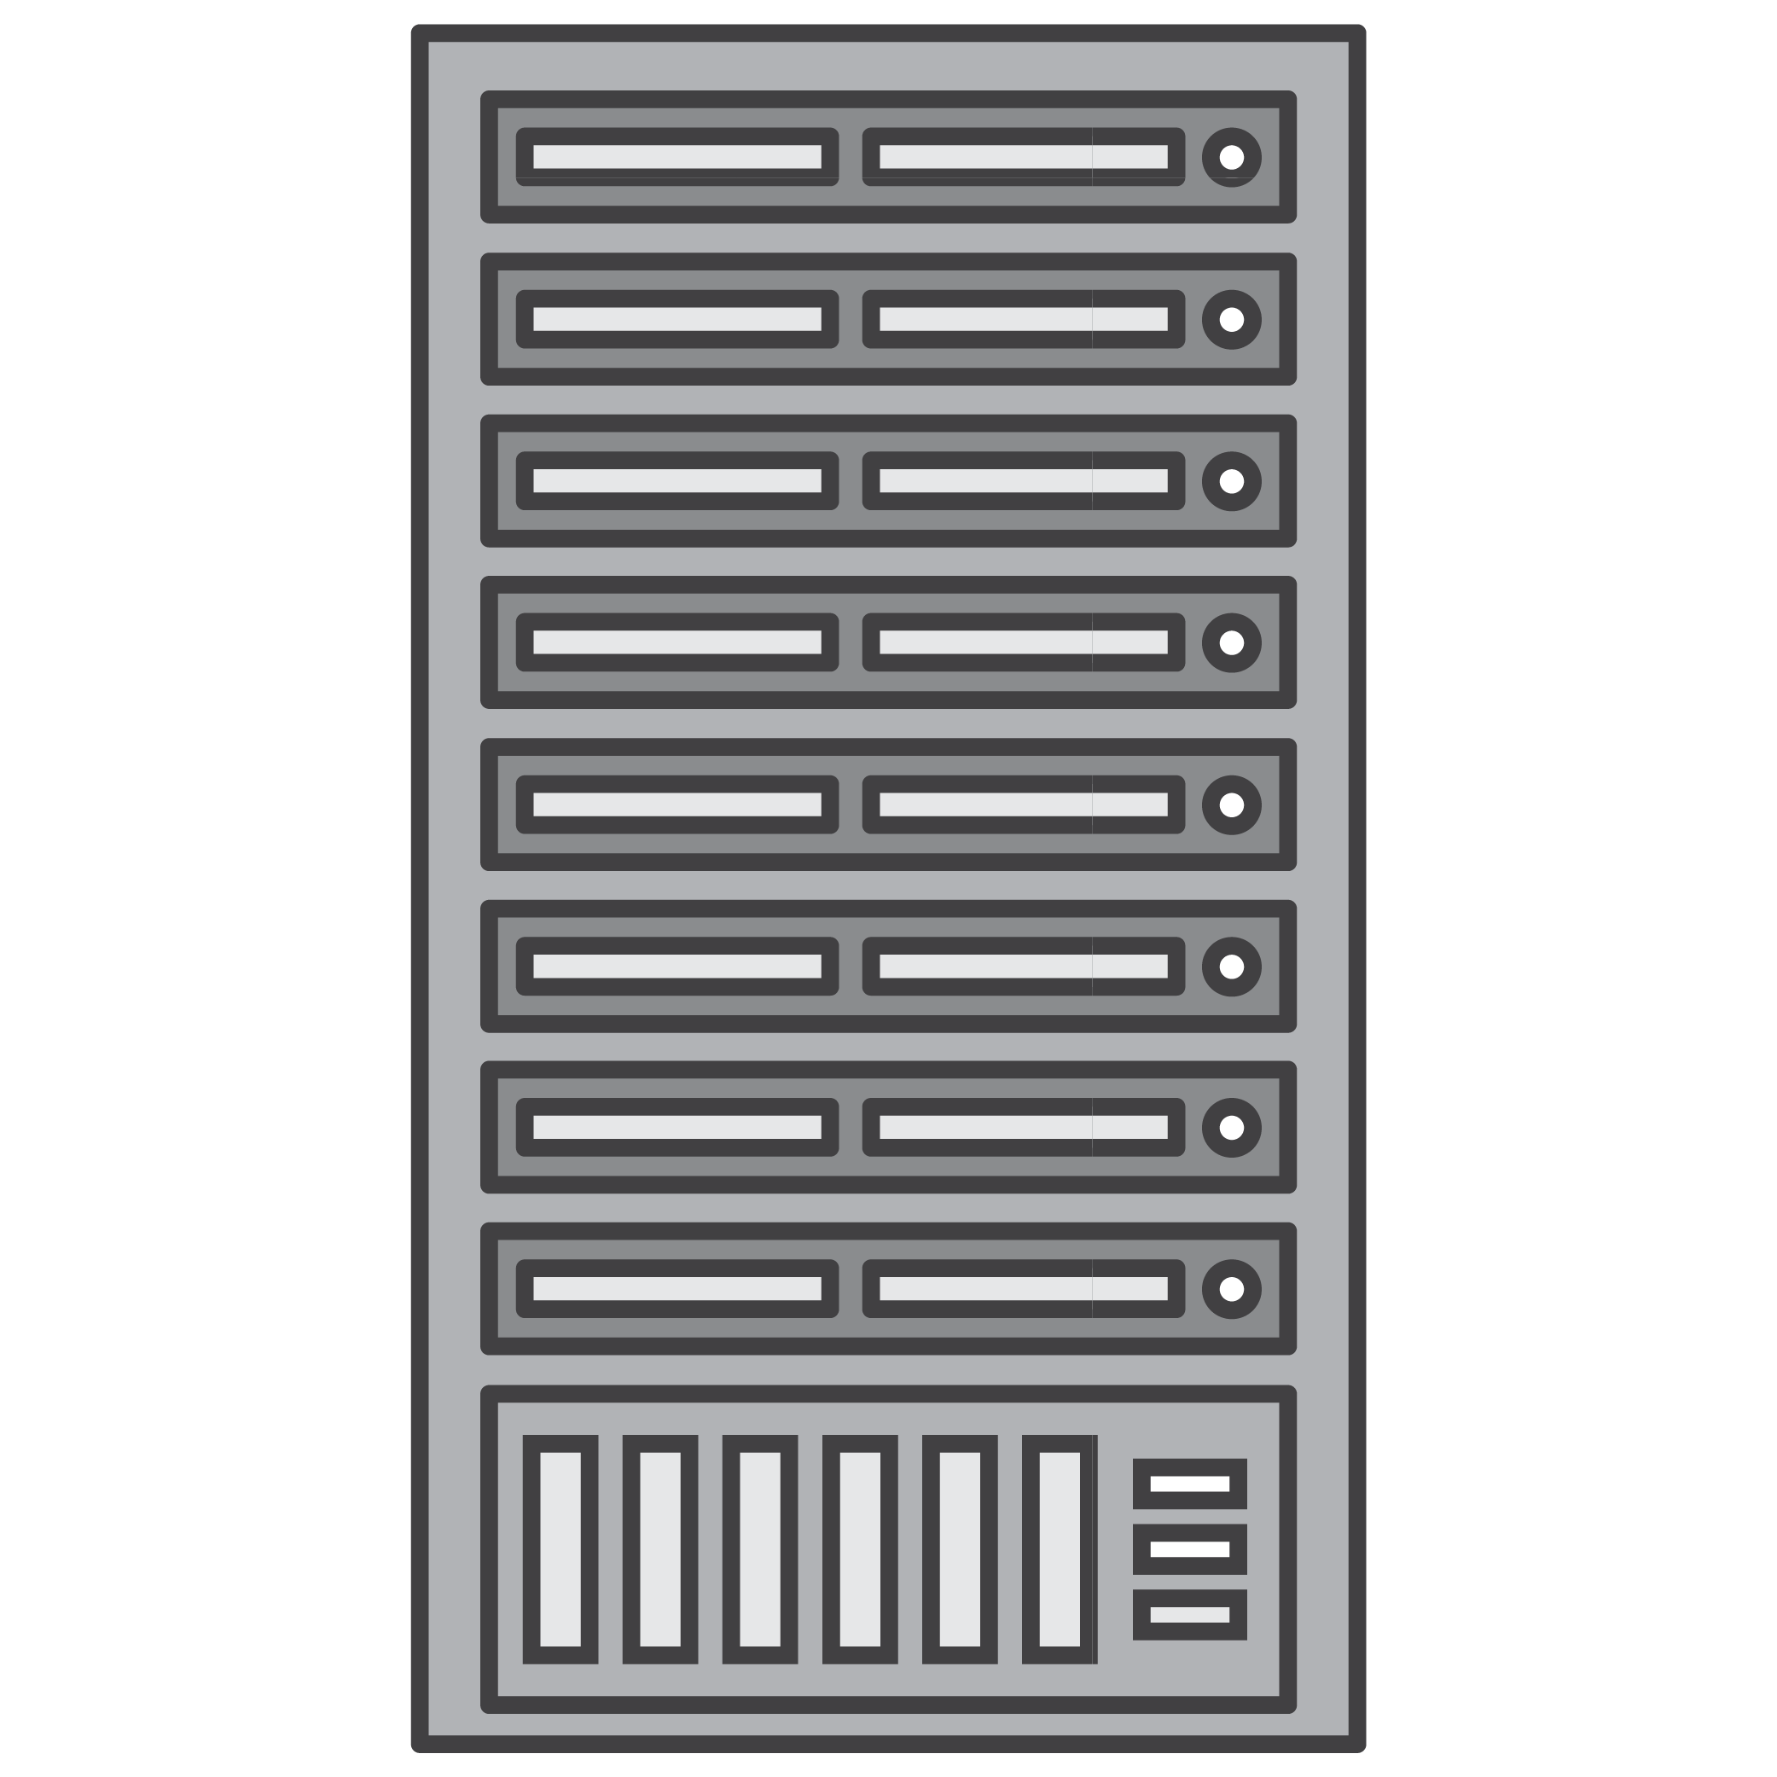



What is Amazon EC2 instance store?
EC2 instances
Local to instance
Non-persistent data store
Available on several EC2 families
Data is not replicated (by default)
No snapshot support
SSD or NVMe
Instance Store
or
Physical Host
Notes:
An instance store provides temporary block-level storage for your instance. This storage is located on disks that are physically attached to the host computer. Instance store is ideal for temporary storage of information that changes frequently, such as buffers, caches, scratch data, and other temporary content, or for data that is replicated across a fleet of instances, such as a load-balanced pool of web servers.
For Nitro instances – the “d” in the instance name indicates the availability of instance store.

Slide 27
2
Shared file system

Slide 28
Amazon Elastic File System

Slide 29
Amazon Elastic File System (Amazon EFS)
Simple, serverless, set-and-forget, elastic file system for AWS compute
Serverless shared storage
Simple and highly reliable
Performant and cost-optimized
Serverless and scalable
No provisioning, scale capacity, connections, and IOPS
Elastic
Pay only for capacity used
Performance built-in, scales with capacity
Performant
10s of GB/s of throughput and 500,000+ IOPS
Full AWS compute integration
EC2 Instances, containers, and serverless
Supports 10,000s of connections
Highly durable and available Designed for 11 9s of durability
99.99% availability SLA
Four storage classes
Automatic lifecycle-based cost optimization
Notes:
So what is Amazon EFS? We launched EFS back in 2016 to give customers a super simple, ’set and forget’, fully managed, cloud-native file system. You can get up and running in just seconds in as little as two clicks, and have petabyte-scale elastic storage that’s trivially easy to use. EFS provides the capabilities and integrations you need to confidently run business-critical apps needing shared file storage in the cloud.
EFS is elastic, automatically scaling up or down as you add or remove files, and you pay only for what you use. Your performance automatically scales with your capacity. Which, by the way, EFS file systems scale to petabytes in size.
EFS is also highly available and designed to be highly durable. We offer a 4 9s availability SLA and we’re designed for 11 9s of data durability. To achieve these levels of availability and durability, all files and directories are redundantly stored within and across multiple Availability Zones or AZs. EFS file systems can withstand the full loss of a single AZ, while still providing the same quality of service in the other AZs.
EFS is serverless, you don’t need to provision or manage any infrastructure or capacity. And as your workload scales up, so does your file system, automatically accommodating any additional storage or connection capacity that you need.
Speaking of connections, EFS file systems support up to 10s of thousands of concurrent clients, no matter the type. These could be traditional EC2 instances, containers running in one of your self managed clusters or in one of the AWS container services, Elastic Container Service, Elastic Kubernetes Service, and Fargate – or in a serverless function running in AWS Lambda. You can also access your EFS file systems from on-premises via AWS DirectConnect and AWS VPN.
In terms of performance, EFS file systems provide low, consistent latencies (in the single digit millisecond range for active file system workloads), and can scale to 10s of GB/s of throughput and support over 500,000 IOPS. We’ll talk more about performance towards the end of this session.
And finally, EFS storage classes provide you with automatic cost-optimization and help you achieve an optimal price/performance blend for your workloads. With our native lifecycle management capability, files that you aren’t using frequently will be automatically moved from the Standard storage class to the lower-cost EFS Infrequent Access (IA) storage class, completely transparently to users and applications. IA costs just 2 and a half cents, 92% less than Standard. And with this built in capability, what we see is roughly 80% of data isn’t accessed frequently, you can achieve an effective storage price of just $0.08/GB-month. Introducing EFS Asteroid, adding two additional single zone storage classes, for a total of four, and cloud file storage starting at just $0.0xxx/GB-Month, and an effective storage price of just $0.0xx/GB-month.

Slide 30
Amazon EFS meets you where you are today and tomorrow
Migrate: lift and shift to AWS cloud without refactoring application
Optimize: enable cost efficiency
Modernize: build micro-services into application with common data platform
Innovate: improve development efficiency, build new features, enter new markets
Migrate
Operate
Innovate
Optimize
Modernize
Notes:
So when we talk to customers about moving to and growing in the cloud with EFS, one thing that excites them, besides how easy it is to get started, is how EFS helps minimize risk along their journey.
EFS is there every step of the way, and it gives customers an easy way to modernize their stacks at their own pace.
Rather than getting bogged down in having to manage your own storage infrastructure, you can simplify operations, reduce cost, increase agility, and get more out of your data, simply by moving to fully managed AWS services like Amazon EFS.
It’s super easy to lift and shift your applications onto EFS with minimal disruption, and again, you can get started in just minutes in as little as two clicks. If you’re already running application backed by network file storage today, EFS provides the same type of interface that your applications, developers, and users are accustomed to.
Once you’ve migrated to workloads, we make it easy to optimize your storage spend. EFS offers automatic cost savings which we’ll discuss more in a bit. And since AWS offers a rich set of services across all product categories, like compute, containers, storage, and analytics, and with all the integrations we’ve built between them, you can modernize your applications on your schedule, while gaining immediate benefits from running in the AWS cloud.
Once modernized, running on fully managed, elastic cloud infrastructure, results in further development and operational efficiency, which enables you to build and deliver more features and capabilities to your customers in a shorter amount of time.

Slide 31
Use cases for Amazon EFS
Home directories
DevOps
Application dev. & test
Enterprise apps
Database backups
Web serving & content mgmt.
Analytics
Machine learning
Media workflows
Business Criticality
Metadata-intensive jobs
Scale-out jobs
Low latency and serial I/O
High throughput and parallel I/O
Notes:
EFS use cases range from home directories and shared storage for devops projects, to enterprise apps, web content management, analytics, machine learning, and more.

Slide 32






Accelerate modernization and innovation
Highly integrated, serverless shared access
VPC
VPC
Intra-region
VPC Peering
NFS Clients
Amazon EC2
NFS Clients
Amazon EKS
Other AWS Regions
Inter-region
VPC Peering
AWS Fargate
Amazon EFS
Amazon ECS
AWS VPN
AWS Direct Connect
On-Premises Servers
AWS Lambda
Amazon SageMaker
Notes:
EFS is serverless, you don’t need to provision or manage any infrastructure or capacity.
EFS file systems can be shared with up to 10s of thousands of concurrent clients, no matter the type. These could be traditional EC2 instances, containers running in one of your self managed clusters or in one of the AWS container services, Elastic Container Service, Elastic Kubernetes Service, and Fargate – or in a serverless function running in AWS Lambda.
Not shown in this visual, but customers can also using EFS with AWS ML platform – Amazon SageMaker.
You can also access your EFS file systems from on-premises via AWS DirectConnect and AWS VPN.

Slide 33



Build and deploy with confidence
Highly available and durable
Amazon EFS Standard
Amazon EFS One Zone
Availability Zone
AWS Backup
Availability Zone
Availability Zone
Availability Zone
99.99% availability SLA Designed for 11 9’s durability
99.9% availability SLA Designed for 11 9’s* durability
* Data stored in these storage classes may be lost in the event of a disaster or other fault that affects all copies of the data within the Availability Zone (AZ), or in the event of AZ destruction.
Notes:
EFS also supports multiple storage classes that we’ll cover in a later slide, and integrates with AWS Backup to allow for complete data protection to complement the durability of EFS.

Slide 34
Performance that scales with your application
Amazon EFS can scale up to 10s of GB/s of throughput and 500,000+ IOPS
Performance Modes
General Purpose Up to 35K read and 7K write IOPS
Max I/O Up to 500,000+ IOPS
Throughput Modes
Bursting Throughput Auto-scale throughput based on storage
Provisioned Throughput User-defined throughput independent of storage. Additional charges apply.
Notes:
EFS can scale with your application, and has multiple performance and throughput modes that allow you to find the best performance and cost efficiency for each of your workloads.

Slide 35
Automatic cost optimization
Using EFS storage classes and lifecycle management
$0.043/GB-Month* Effective storage cost
$0.08/GB-Month* Effective storage cost
EFS One Zone
EFS Standard
$0.16/GB-month*
$0.30/GB-month*
EFS One Zone-IA
EFS Standard-IA
Cost-optimized for less accessed files
$0.01333/GB-month* for storage
$0.01/GB* for access
Cost-optimized for less accessed files
$0.025/GB-month* for storage
$0.01/GB* for access
*Pricing in the US East (N. Virginia) Region. Assumes 80% of the files are infrequently accessed
Notes:
Let’s talk a bit more about why EFS is cost optimized. If you take away one key insight from this session, I’d like it to be this: with EFS, your effective storage price is just 8 cents per gigabyte per month. And at this price, you get all of the fully managed features EFS provides right out of the box. And if you do a total cost of ownership analysis comparing this to running your own file system storage infrastructure, what you’ll find is that EFS is 90% more cost effective than doing it yourself.
Let’s break that down a little bit more. Lifecycle management monitors your workload and file access pattern, and automatically saves you money by moving files you’re not accessing frequently from EFS Standard into the lower cost EFS IA. There’s a generally accepted industry estimate that 80% of data isn’t accessed frequently – we actually analyzed our own usage data that we’ve gathered over the past 4 and a half years of operation, and validated this estimate. Using that 80-20 rule, where 20% of your files are actively used and the other 80% are not, with our built-in cost optimization, your effective price is just 8 cents per GB per month.

Slide 36
Amazon FSx
Notes:
Amazon FSx makes it easy and cost effective to launch and run popular file systems that are fully managed by AWS. With Amazon FSx, you can leverage the rich feature sets and fast performance of widely-used open source and commercially-licensed file systems, while avoiding time-consuming administrative tasks such as hardware provisioning, software configuration, patching, and backups. It provides cost-efficient capacity with high levels of reliability, and integrates with a broad portfolio of AWS services to enable faster innovation.
Amazon FSx provides two file systems to choose from: Amazon FSx for Windows File Server for business applications and Amazon FSx for Lustre for compute-intensive workloads.

Slide 37

Amazon FSx for Windows File Server
Fully managed file storage built on Windows Server
Easy migration to AWS
Notes:
Amazon FSx for Windows File Server provides fully managed file storage that is accessible over the industry-standard Server Message Block (SMB) protocol.

Slide 38
Fully managed Windows file storage means you no longer have to …
Managed hardware
Plan capacity
Procure and purchase hardware
Set up storage servers and volumes
Detect and address hardware failures
Incur high upfront costs
Managed software
Install and configure server software
Set up and configure file systems
Apply Windows updates
Manage software licenses
Manage backups
Monitor security
Notes:
With FSx for Windows, you no longer have to worry about setting up and provisioning file servers and storage volumes, replicating data, installing file server software updates and patches, managing failover and failback, and manually performing backups.

Slide 39







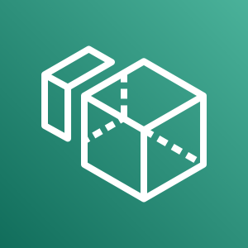



Agile, scalable, and automated
Monitoring and automation
Amazon CloudWatch
AWS CloudTrail
AWS CloudFormation
Live storage and throughput scaling
New
New
Amazon EC2
VMware Cloud on AWS
Amazon AppStream 2.0
Amazon WorkSpaces
Amazon ECS
AWS DataSync
AWS Backup
Compute instances
Data management
Notes:
By supporting the SMB protocol, Amazon FSx can connect your file system to Amazon Elastic Compute Cloud (Amazon EC2), Amazon Elastic Container Service (Amazon ECS), VMware Cloud on AWS, Amazon WorkSpaces, and Amazon AppStream 2.0 instances. Amazon FSx supports all Windows versions starting from Windows Server 2008 and Windows 7, as well as current versions of Linux and MacOS. Amazon FSx also supports on-premises access via AWS Direct Connect or AWS VPN, and access from multiple VPCs, accounts, and regions using VPC Peering or AWS Transit Gateway. Amazon FSx File Gateway provides efficient, low-latency on-premises access with a local cache for frequently accessed file data.

Slide 40
Flexible price and performance options
Storage type flexibility (SSD / HDD)
Deployment type flexibility (Single-AZ / Multi-AZ)
Select throughput and storage independently
Choice of in-line snapshots and backups stored in S3
Data deduplication and compression
Notes:
FSx for Windows offers the flexibility and performance options that allow you to determine the best fit for your workloads – ranging from SSD and HDD storage classes, Single and Multi-AZ deployment options, and the ability to select storage and throughput independently. FSx also supports Windows shadow copies in addition to the integration with AWS backup and the automatic daily backups to S3.
You can also enable data deduplication and compression to automatically reduce costs with redundant data being stored in your FSx filesystem, typically offering a 50-80% savings depending on the type of data being stored.

Slide 41
Fully featured, secure, reliable, and scalable
Accessibility
✓ Full SMB protocol support
✓ Windows Server 2008+, Windows 7+, Linux, and MacOS
✓ EC2, WorkSpaces and AppStream 2.0
✓ VMware Cloud on AWS
✓ Amazon ECS and Amazon EKS containers
✓ Cross-VPC / Account / Region access
✓ On-premises access (DirectConnect / VPN)
Availability and durability
✓ High availability – automatic recovery
✓ High durability – automatic replication
✓ Multi-AZ deployment option
✓ SMB continuous availability (CA)
Cost optimization
✓ Storage type flexibility (SSD / HDD)
✓ Deployment type flexibility (Single-AZ / Multi-AZ)
✓ Live scaling of storage capacity
✓ Data deduplication and compression
Performance and scale
✓ Consistent, sub-millisecond latencies
✓ PB-scale storage scalability
✓ Tens of GB/s throughput scalability
✓ Millions of IOPS scalability
✓ Select throughput and storage independently
✓ Server-side and client-side caching
✓ SMB Multichannel
✓ Performance monitoring via CloudWatch
✓ Live scaling of throughput capacity
Data protection
✓ Snapshots (with end-user file restore)
✓ Backups
Administration
✓ Active directory integration
✓ Managing file shares
✓ Monitoring user sessions and open files
✓ Restoring locked files
✓ User storage quotas
✓ Monitoring actions via AWS CloudTrail
Security and compliance
✓ Encryption at rest and in transit
✓ Kerberos authentication
✓ Access controls via NTFS ACLs, share ACLs, VPC, and IAM
✓ PCI DSS, ISO, SOC, GDPR, IRAP, and HIPAA compliances
Notes:
FSx offers a wide range of features for accessibility, ease of administration, availability and durability, performance and scalability, cost optimization, data protection, and most of all, security and compliance.

Slide 42








Amazon FSx for Lustre
Fully managed Lustre file system for high performance workloads
Massively scalable performance
Seamless access to your data repositories
Simple and fully managed
Native file system interface
Cost-optimized for compute-intensive workloads
Secure and compliant
Notes:
This why we created Amazon FSx for Lustre.
As it’s a parallel filesystem, you can hit the same file or directory with thousands of instances and get a massive amount of work done in parallel, it has sub-millisecond latency, and it is POSIX Compliant. A big key item here is that it’s a fully managed file system service. Parallel file systems are great, but they are tough to setup and run.
That goes for every parallel file system in the market, be it Lustre, or anything else, they can take away a lot of hours in the form of management, support, tuning from the researchers, scientists and IT teams, these filesystems are very complex to setup and run yourself.
Lustre – leader
Fast launch from console

Slide 43


Customers continue to increase the size of their workloads on AWS across industry verticals and application areas
Industries and example use cases
Application areas
Financial services: Modeling and analytics
Life Sciences: Genome analysis
Media and Entertainment: Rendering and transcoding
Big data analytics
Machine learning
For every $1 spent on high performance computing, businesses see $463 in incremental revenues and $44 in incremental profit¹
Automotive: ECU simulations and object detection
Semiconductor: Electronic design automation
Oil and gas: Seismic data processing
High-performance
computing
¹ High Performance Computing on AWS Redefines What is Possible
Notes:
Customers in many industries and application areas process vast data sets to develop products and make business decisions
These represent the main verticals that FSx for Lustre tends to work with (read through them)
** Summarize the verticals above – and if customers want more detail per vertical, see below and pick out items per vertical:
===============================
HPC
Scientists, researchers and engineers solve complex, compute-intensive problems and typically turn to a different type of compute profile, often involving clusters of computers to drive maximum CPU processing to process specific workload types.
HPC workloads touch all the horizontals and verticals you see here – from machine learning to oil & gas discovery, pharmaceuticals, financial services like high frequency trading, and also genomics. HPC workloads need to process massive amounts of data and must be accessed by multiple compute instances with high levels of throughput.
FSX is ideal for HPC workloads because it provides a file system that’s optimized for all of this, with POSIX file system access across thousands of EC2 instances and EKS containers.
FSx is integrated with several key services from our HPC group
If you use AWS Batch to manage your HPC compute resource deployment, you can also use it to manage FSx persistent and scratch file systems. You can use Batch to dynamically provision the optimal quantity and type of compute resources based on the volume and specific resource requirements of the batch jobs submitted.
You can use ParallelCluster to automatically create a new FSx file system, or specify an existing FSx file system to use, as part of the cluster creation process.
The AWS HPC team regularly uses FSx for Lustre as part of their solution stack to help customers in a wide array of disciplines to remove storage as the performance bottleneck, and to finish workloads much faster.
ML
Machine learning workloads use massive amounts of training data. These workloads often use shared file storage because multiple compute instances need to process the training datasets concurrently.
FSx is optimal for ML workloads, because it provides massively parallel shared file storage with high throughput and consistent, low latencies to process the ML training datasets. FSx for Lustre also speeds up your training jobs by making your S3 data automatically available to SageMaker at high speeds.
FSx for Lustre integrates with SageMaker as a direct data source, and simplifies your ML workloads.
So we also have verticals that touch across the HPC and ML horizontal categories.
Life sciences & genomics
A large number of current FSx for Lustre customers are in the life sciences field. Use cases include genomic sequencing, cancer and tumor research, patient therapies, and artificial intelligence uses within the field.
We work very closely with our HCLS team and also have an active Genomics Transfer and Store migration play with them. Its amazing when you consider the amount of genomic specific data that is being generated every year, some estimates put it at about 40EB.
As an example, the COVID-19 crisis resulted in high use demand of FSx for Lustre for genomic sequencing of the virus by numerous firms seeking the fastest possible advances in vaccinations, therapies and testing.
Media processing and transcoding
Media data processing workloads, like video rendering, visual effects, and media production, need the compute and storage resources to handle the massive amounts of data being created.
The different media data processing workloads have different file access requirements. Some workloads require access to the massive data sets, some require high throughput, and some require high IOPS.
FSx is well suited here because much of this business is spin up and spin down, and we can help them optimize for this and make it very cost effective.
Big data and Analytics
Big data analytics use cases, including fraud detection and financial analysis, meshed data analysis where you get data from lots of different sources that normally wouldn’t be combined, and you make sense of it.
This all produces massive volumes of data that need high-performance storage to power data-intensive applications. Processing the ever-increasing volume of data can be costly and complicated.
Financial modeling
This seems to be a growing sector for managed cloud file systems as many of these hedge funds, investment funds, private equity companies are funding their internal quantitative teams, and the cost of compute and storage on-prem.
A recent study in 2020 (Valuewalk) estimates that over 90% of Hedge Funds will be on the cloud by 2024. If you look at the cut backs in hedge funds since Covid, the ones that went to cloud, and were able to quickly scale back, have a much better chance of survival then on-prem counterparts.
Electronic design automation
Electronic design automation (EDA) is a high-performance application used to simulate performance and failures during the design phase of silicon chip production.
FSx helps to innovate faster to design and verify new products, and also, to scale up and down to meet demand.
Autonomous vehicles
AV is kind of a new industry, didn’t exist a few years ago. But the data sets are growing exponentially.
Customers developing autonomous vehicle (AV) systems often test models by running simulations and training on massive amounts of vehicle sensor and camera data to ensure vehicle safety.
The AV Development workflow has multiple workloads from ingest, processing, analytics, labeling, training, and simulation/validation. Often the applications for training and simulation/validation require POSIX compliant, high throughput, low latency file systems, and FSx for Lustre is commonly used.
FSx for Lustre enables you to access that data simultaneously from thousands of nodes with high levels of performance, allowing you to more easily run simulations at scale and to accelerate model development.

Slide 44
FSx for Lustre deployment options
Optional
High and scalable performance
Amazon FSx for Lustre
SSD Scratch file system
Amazon FSx for Lustre
SSD Persistent file system
Amazon FSx for Lustre
HDD Persistent file system
In all options, we support encryption at-rest and in-transit*
Notes:
There are 3 main considerations when selecting a deployment option for FSx for Lustre, they all depend on the workload profile. File systems can be either Scratch for short term workloads seeking highest performance and cost optimization, or Persistent, which is replicated in the same AZ, and is suited for longer running workloads that require higher availability over time.
There is also a choice between storage type, SSD or HDD. SSD offers the lowest latency and highest IOPs and throughput performance and can be used with either Scratch or Persistent. HDD helps with cost sensitive workloads and is optimized for large, sequential file operations. The HDD tier supports Persistent only, and also provides an option of an SSD-cache layer to help meet the needs of mixed workloads that can also benefit from SSD performance while maintaining a mostly HDD cost basis. HDD is only available as a persistent file system, and can be used with S3 or backups for durability. For both SSD and HDD, there are different price/throughput options for cost optimization.
Amazon FSx for Lustre file systems support encryption at-rest and in-transit. Scratch file systems are encrypted at-rest with keys managed by the service and encrypted in-transit when accessed from supported EC2 instances. Persistent file systems are encrypted at-rest using either customer managed or AWS Managed Customer Master Key (CMK) in AWS KMS. Persistent file systems are encrypted in-transit when accessed from supported EC2 instances. See the Amazon FSx documentation for details on regions where in-transit encryption is supported for scratch and persistent file systems.

Slide 45
Multiple FSx for Lustre throughput options and deployment types allow customers to optimize storage cost and performance
Storage type | Baseline throughput | Price per GB-month (in IAD) ¹
 |  | Persistent storage | Scratch Storage
HDD (New!) | 12 MB/s per TiB | $0.025 $0.041 (with SSD cache) | -
 | 40 MB/s per TiB | $0.083 $0.099 (with SSD cache) | -
SSD | 50 MB/s per TiB | $0.140 | -
 | 100 MB/s per TiB | $0.190 | -
 | 200 MB/s per TiB | $0.290 | $0.14
Scratch file systems are ideal for temporary storage and shorter-term processing of data.
Data is not replicated and does not persist if a file server fails.
File systems with SSD storage can burst up to 1.3 GB/s per TiB
Sample pricing for AID - US East (N. Virginia)
¹ Prices are as of September 25, 2020 and subject to change without notice. Pricing varies by AWS Region. For current pricing information, see the Amazon FSx for Lustre Pricing page on the AWS website.
Notes:
scratch or persistent, plus the 3 flavors of persistent
prices range from 14 to 29 c per GB per mo
lowest price tiers, Scratch or 50MB/sec Persistent. 20c / hr / tb
if you have instances in different AZs than your FSx file system, then Cross AZ costs could apply too
-----------------------------
Scratch – Partial Use Time
Scenario: You have a scratch file system in the US East (N. Virginia) region, which has been provisioned with 4800 GB of storage capacity, and you spin up your file system for an 8-hour workload every day and then shut it down. You do this for 30 days (a month).
Calculations:
Calculate the cost per GB-hour
Rate per GB-month / days per month / hours per day = GB-hour
$0.14 GB-month / 30 days per month / 24 hours per day = $0.000194 per GB-hour
Calculate workflow costs
Number of GB x Rate per GB-hour x Number of hours per day x Number of days per month
4800 GB x $0.000194 per GB-hour x 8 hours per day x 30 days per month = $224
Persistent – 200MB
Scenario: You have a persistent file system in the US East (N. Virginia) region, which has been provisioned with 4800 GB of storage capacity and per unit storage throughput of 200 MB per second per TiB (MBps/TiB), and you retain your file system for 20 days to execute your long-lived workload then shut it down.
Calculations:
Calculate the cost per GB-hour
Rate per GB-month / days per month / hours per day = GB-hour
$0.29 GB-month / 30 days per month / 24 hours per day = $0.000403 per GB-hour
Calculate workflow costs
Number of GB x Rate per GB-hour x Hours per day x Number of days per month
4800 GB x $0.000403 per GB-hour x 24 hours per day x 20 days per month = $929
The pricing is of course based on scratch or persistent. The demo we have discusses some more differences related to burst rates, and also gives a quick view of how the demo is priced.
- Scratch tier is at 200 MB / sec per TB.
- Persistent has 3 flavors, 50 / 100 / 200 MB / sec per TB.
- Persistent tiers are highly available for single AZ HA, and, like Scratch tier, can still be paired with S3 for even more durability
For the lowest price tiers, Scratch or 50MB/sec Persistent – this comes out to about 20 cents / per TB / per hour for processing a workload.
We’ve done some comparisons to our cloud competitors can we come out very favorably against them when it comes to performance and pricing.
Also, please note, that if you have instances in different AZs than your FSx file system, then Cross AZ costs could apply too

Slide 46
3
Object Stores

Slide 47
Amazon S3
Notes:
And now we’re going to talk about everyone’s favorite object store, Amazon S3.

Slide 48

Amazon S3 (Simple Storage Service)
Web accessible object store (through API or HTTPS)
Highly durable (99.999999999% design)
Limitlessly scalable
Multiple Tiers to match your workload
Data Lifecycle Rules
Static Website Hosting
Security, Compliance, and Audit capabilities
Standard Storage Pricing (us-east-1) - $0.023 per GB
Notes:
11 Nines of durability: 99.999999999% - expected loss of 1 object out of 10M stored in 10k years
Pricing: $0.023 per GB for the first 50 TB/ Month then drops to $0.022 – (approx. $23/TB for std, details on classes slide)
https://aws.amazon.com/s3/pricing/

Slide 49






Your choice of object storage classes
S3 Standard
S3 Intelligent-Tiering
S3 Standard-IA
S3 One Zone-IA
S3 Glacier
S3 Glacier
Deep Archive
Frequent
Access Frequency
Infrequent
Active, frequently accessed data
Milliseconds access
> 3 AZ
$0.0210/GB
Data with changing access patterns
Milliseconds access
> 3 AZ
$0.0210 to $0.0125/GB ($0.004 to $0.00099/GB Archive)
No retrieval fees
Monitoring fee per Obj.
Min storage duration
Min object size
Infrequently accessed data
Milliseconds access
> 3 AZ
$0.0125/GB
Retrieval fee per GB
Min storage duration
Min object size
Re-creatable, less accessed data
Milliseconds access
1 AZ
$0.0100/GB
Retrieval fee per GB
Min storage duration
Min object size
Archive data
Select minutes or hours
> 3 AZ
$0.0040/GB – ($4.10/TB)
Retrieval fee per GB
Min storage duration
Min object size
Archive data
Select 12 or 48 hours
> 3 AZ
$0.00099/GB - ($1.01/TB)
Retrieval fee per GB
Min storage duration
Min object size
Notes:
Amazon S3 offers a range of storage classes designed for different use cases. These include S3 Standard for general-purpose storage of frequently accessed data; S3 Intelligent-Tiering for data with unknown or changing access patterns; S3 Standard-Infrequent Access (S3 Standard-IA) and S3 One Zone-Infrequent Access (S3 One Zone-IA) for long-lived, but less frequently accessed data; and Amazon S3 Glacier (S3 Glacier) and Amazon S3 Glacier Deep Archive (S3 Glacier Deep Archive) for long-term archive and digital preservation.

Slide 50
S3 Management Features
Organize
Monitor
Replicate & Tier
Modify
S3 Tagging
S3 Prefixes
S3 Versioning
CloudWatch
CloudTrail
S3 Event Notifications
S3 Inventory
S3 Glacier Restore Notifications
S3 Storage Lens
AWS Config
S3 Lifecycle
S3 Storage Class Analysis
S3 Intelligent-Tiering
Cross-Region Replication
Replication Time Control (RTC)
S3 Event Notifications + Lambda
S3 Batch Operations
S3 Object Lock
S3 Object Lambda
Notes:
S3 gives you robust capabilities to manage access, cost, replication, and data protection. S3 Access Points make it easy to manage data access with specific permissions for your applications using a shared data set. S3 Replication manages data replication within the region or to other regions. S3 Batch Operations helps manage large scale changes across billions of objects. S3 Storage Lens delivers organization-wide visibility into object storage usage and activity trends. Since S3 works with AWS Lambda, you can log activities, define alerts, and automate workflows without managing additional infrastructure.
Store your data in Amazon S3 and secure it from unauthorized access with encryption features and access management tools. S3 is the only object storage service that allows you to block public access to all of your objects at the bucket or the account level with S3 Block Public Access.
With S3 Object Lambda, you can add your own code to S3 GET requests to modify and process data as it is returned to an application.

Slide 51


S3 Access Management & Security
Deep integration with AWS Identity and Access Management (IAM)
Access Control Lists (ACLs), S3 bucket policies, and S3 Access Points
Query String Authentication
Audit Logs
S3 supports both server-side & client-side encryption
S3 Block Public Access to ensure S3 buckets and objects do not have public access
Amazon Macie to discover, classify, and protect sensitive data stored in Amazon S3
Access Analyzer for S3
Amazon S3 Object Lock
AWS PrivateLink for S3
Amazon GuardDuty for S3
Notes:
* Deep integration with AWS Identity and Access Management (IAM) for user access management * Access Control Lists (ACLs) to make individual objects accessible to authorized users * bucket policies to configure permissions for all objects within a single S3 bucket * Query String Authentication to grant time-limited access to others with temporary URLs * Audit Logs that list the requests made against your S3 resources * S3 supports server-side (with three key management options) and client-side encryption * S3 Inventory to check the encryption status of S3 objects * S3 Block Public Access is a set of security controls to ensure S3 buckets and objects do not have public access * Amazon Macie to discover, classify, and protect sensitive data stored in Amazon S3

Slide 52




S3 Replication
Replicate within the same AWS Region
Replicate to a bucket with retention controls (in the same or different AWS Region)
Replication Time Control (RTC) 15 minute replication SLA
Replicate faster to a different AWS Region, backed by an SLA + replication metrics
Replicate to a
different AWS Region
Amazon Simple Storage Service
Notes:
With S3 Cross-Region Replication (CRR), you can replicate objects (and their respective metadata and object tags) into other AWS Regions for reduced latency, compliance, security, disaster recovery, and other use cases. S3 CRR can be configured from a single source S3 bucket to replicate objects into one or more destination buckets in another AWS Region.
Amazon S3 SRR is an S3 feature that automatically replicates data between buckets within the same AWS Region. With SRR, you can set up replication at a bucket level, a shared prefix level, or an object level using S3 object tags. You can use SRR to make one or more copies of your data in the same AWS Region. SRR helps you address data sovereignty and compliance requirements by keeping a copy of your data in a separate AWS account in the same region as the original.
Amazon S3 replication time control helps you meet compliance "or business requirements" for data replication and provides visibility into Amazon S3 replication activity. Replication time control replicates most objects "that you upload" to Amazon S3 in seconds, and 99.99 percent of those objects within 15 minutes.

Slide 53
S3 High Level CLI operations
Command | Description
cp | Copies a local file or S3 object to another location locally or in S3.
ls | List S3 objects and common prefixes under a prefix or all S3 buckets.
mb | Creates an S3 bucket.
mv | Moves a local file or S3 object to another location locally or in S3.
presign | Generate a pre-signed URL for an Amazon S3 object. This allows anyone who receives the pre-signed URL to retrieve the S3 object with an HTTP GET request.
rb | Deletes an empty S3 bucket.
rm | Deletes an S3 object.
sync | Syncs directories and S3 prefixes. Recursively copies new and updated files from the source directory to the destination.
website | Set the website configuration for a bucket.

Slide 54
S3 API Operations (complete)
abort-multipart-upload
complete-multipart-upload
copy-object
create-bucket
create-multipart-upload
delete-bucket
delete-bucket-analytics-configuration
delete-bucket-cors
delete-bucket-encryption
delete-bucket-inventory-configuration
delete-bucket-lifecycle
delete-bucket-metrics-configuration
delete-bucket-policy
delete-bucket-replication
delete-bucket-tagging
delete-bucket-website
delete-object
delete-object-tagging
delete-objects
delete-public-access-block
get-bucket-accelerate-configuration
get-bucket-acl
get-bucket-analytics-configuration
get-bucket-cors
get-bucket-encryption
get-bucket-inventory-configuration
get-bucket-lifecycle-configuration
get-bucket-location
get-bucket-logging
get-bucket-metrics-configuration
get-bucket-notification-configuration
get-bucket-policy
get-bucket-policy-status
get-bucket-replication
get-bucket-request-payment
get-bucket-tagging
get-bucket-versioning
get-bucket-website
get-object
get-object-acl
get-object-legal-hold
get-object-lock-configuration
get-object-retention
get-object-tagging
get-object-torrent
get-public-access-block
head-bucket
head-object
list-bucket-analytics-configurations
list-bucket-inventory-configurations
list-bucket-metrics-configurations
list-buckets
list-multipart-uploads
list-object-versions
list-objects
list-objects-v2
list-parts
put-bucket-accelerate-configuration
put-bucket-acl
put-bucket-analytics-configuration
put-bucket-cors
put-bucket-encryption
put-bucket-inventory-configuration
put-bucket-lifecycle-configuration
put-bucket-logging
put-bucket-metrics-configuration
put-bucket-notification-configuration
put-bucket-policy
put-bucket-replication
put-bucket-request-payment
put-bucket-tagging
put-bucket-versioning
put-bucket-website
put-object
put-object-acl
put-object-legal-hold
put-object-lock-configuration
put-object-retention
put-object-tagging
put-public-access-block
restore-object
select-object-content
upload-part
upload-part-copy
wait

Slide 55
4
Data Transfer and Edge Processing

Slide 56









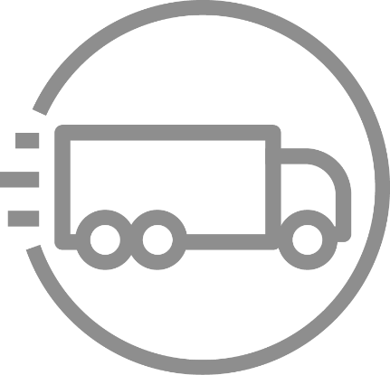


Many Options for Data Transfer
AWS Direct Connect
Amazon Kinesis Firehose
Amazon Kinesis Data Streams
Amazon Kinesis Video Streams
Amazon S3 Transfer Acceleration
AWS Storage Gateway
AWS
Database Migration Service
AWS
Snowcone
AWS Snowball Edge
AWS Snowmobile
AWS DataSync
AWS Transfer Family
Notes:
Data Transfer: And once customers have decided to move their data to the cloud, AWS has 11 different ways (more than anyone else) to get data in depending on the nature of the data and the application. We have Direct Connect, which is a private connection between an on-premises data center and an AWS Region. For streaming data, customers can use Kinesis Firehose. To send data in bulk, customers can use Snowball, Snowball Edge, or Snowmobile. AWS DataSync is a data transfer service that automates transferring and synchronizing data from an on-premises NAS over the network to S3 and EFS at speeds up to 10x faster than open source tools like Rsync and Robocopy. And for companies that need to use SFTP to move their data, we have AWS Transfer Family. No matter the use case, we have a data transfer method that fits perfectly.
We’re going to focus on Storage Gateway, Snow Family, and Transfer Family in the next section.

Slide 57
AWS Storage Gateway

Slide 58






AWS Storage Gateway On-premises access to virtually unlimited cloud storage
On-premises
AWS Cloud
Storage Services
Management & Monitoring
Application
Server
Storage Gateway
Standard Protocols
HTTPS
User Workstation
Optimized uploads
Storage Gateway Managed Service
Local cache for low latency access
Backup
Server
Deployment options: VMware, Hyper-V, KVM, Amazon EC2, Hardware appliance
Notes:
AWS Storage Gateway addresses the hybrid cloud storage challenges our customers face.
Specifically:
Storage Gateway allows customers to connect to and use key cloud storage services such as Amazon Simple Storage Service (S3), Amazon S3 Glacier, and Amazon Elastic Block Store (EBS).
Additionally, Storage Gateway integrates with AWS services such as: AWS Key Management Service (KMS), AWS Identity and Access Management (IAM), AWS Cloudtrail, AWS Cloudwatch
Storage Gateway easily deploys on-premises, as a virtual machine (we support all the major hypervisors) or via a pre-configured hardware appliance.
By providing a local cache, Storage Gateway enables low latency access to frequently accessed data.
Storage Gateway supports access via standard storage protocols (NFS, SMB, iSCSI, and iSCSI VTL) for on-prem applications to access data stored in Amazon S3. So no changes to customers’ applications.
Data is transferred securely and efficiently between the on-premises environment and AWS.

Slide 59
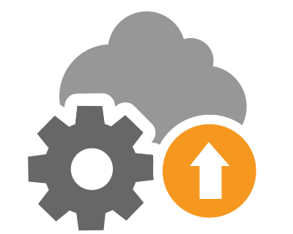
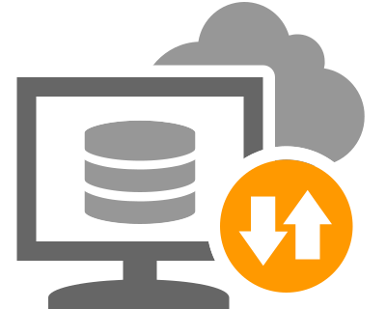

Hybrid storage use cases with Storage Gateway
Enabling cloud workloads Move data to AWS storage for Big Data, cloud bursting, or migration
Backup, archive, and disaster recovery Cost effective storage in AWS with local or cloud restore
Tiered cloud storage Easily add AWS storage to your on-premises environment
Notes:
We see 3 broad categories of hybrid storage where SGW helps customers.
Let’s look in a little more detail at each of these.

Slide 60

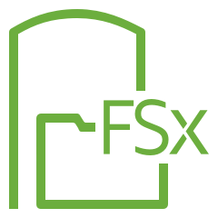


Storage Gateway Family
Amazon S3 File Gateway
Amazon FSx File Gateway
Tape Gateway
Volume Gateway
Store and access objects in Amazon S3 from file-based applications with local caching
Native access to Amazon FSx for on-premises group file shares and home directories
Drop-in replacement for physical tape infrastructure backed by cloud storage with local caching
Block storage on-premises backed by cloud storage with local caching, Amazon EBS snapshots, and clones, integrated with AWS Backup
File-based applications work without change
Access FSx for Windows File Server from on-premises
Easily switch tape backups to AWS
SAN-like with cloud recovery
AWS SFTP server
Customer’s Amazon S3 Bucket
Notes:
Storage Gateway comes in four flavors: – Amazon S3 File Gateway, Amazon FSx File Gateway, Tape Gateway, and Volume Gateway – that seamlessly connect on-premises applications to cloud storage, caching data locally for low-latency access. Your applications connect to the service through a virtual machine or gateway hardware appliance using standard storage protocols, such as NFS, SMB, and iSCSI. The gateway connects to AWS storage services, such as Amazon S3, Amazon S3 Glacier, Amazon S3 Glacier Deep Archive, Amazon FSx for Windows File Server, Amazon EBS, and AWS Backup, providing storage for files, volumes, snapshots, and virtual tapes in AWS. The service includes a highly-optimized and efficient data transfer mechanism, with bandwidth management and automated network resilience.

Slide 61

File Gateway
Connect using NFS v3/v4 or SMB v2/v3 protocols
Files stored as native S3 objects
Metadata is preserved as object user metadata
Object-level encryption with SSE-S3 or SSE-KMS
Fully managed local cache
Read-through, write-back, LRU managed
Notifications through Amazon CloudWatch (e.g., upload complete)
Optimized data transfers
Uploads only sends changes, downloads retrieve file parts needed
Refresh cache by prefix
Optimizes content distribution workloads
Performance
Client writes at up to 4 Gbps
Notes:
Amazon S3 File Gateway enables you to store file data as objects in Amazon S3 cloud storage for data lakes, backups, and ML workflows

Slide 62
File Gateway
Store and access objects in Amazon S3 from file-based applications with local caching
On premises
AWS Cloud
NFS/SMB
File Gateway
HTTPS
lifecycle
Amazon S3
Any S3 storage class
Use cases
Backup on-premises data to the cloud
Shift on-premises storage to cloud-backed file shares
Low-latency on-premises access to cloud storage
Notes:
Amazon S3 File Gateway enables you to store file data as objects in Amazon S3 cloud storage for data lakes, backups, and ML workflows

Slide 63

Connect using the iSCSI block protocol
Volumes stored in AWS reducing on-premises SAN footprint
Thin-provisioned (cached) or local (stored) volume types
Fully managed local cache
Read-through, write-back, LRU managed
Configurable encryption with SSE-S3 or SSE-KMS
Volume snapshots stored in Amazon EBS
Volume Gateway support for AWS Backup
Volume detach/attach
Volume Gateway
Notes:
Volume Gateway presents cloud-backed iSCSI block storage volumes to your on-premises applications. Volume Gateway stores and manages on-premises data in Amazon S3 on your behalf and operates in either cache mode or stored mode. In the cached Volume Gateway mode, your primary data is stored in Amazon S3, while retaining your frequently accessed data locally in the cache for low latency access. In the stored Volume Gateway mode, your primary data is stored locally and your entire dataset is available for low latency access on premises while also asynchronously getting backed up to Amazon S3. In either mode, you can take point-in-time copies of your volumes using AWS Backup, which are stored in AWS as Amazon EBS snapshots. Using Amazon EBS Snapshots enables you to make space-efficient versioned copies of your volumes for data protection, recovery, migration, and various other copy data needs.

Slide 64
Volume Gateway
Block storage on-premises backed by cloud storage
On premises
AWS Cloud
Application
Server
iSCSI
Volume Gateway
HTTPS
Amazon S3
AWS Backup
Amazon EBS
Use cases
Backup on-premises data to the cloud
Migration of volumes to the cloud
DR to the cloud
Notes:
Volume Gateway presents cloud-backed iSCSI block storage volumes to your on-premises applications. Volume Gateway stores and manages on-premises data in Amazon S3 on your behalf and operates in either cache mode or stored mode. In the cached Volume Gateway mode, your primary data is stored in Amazon S3, while retaining your frequently accessed data locally in the cache for low latency access. In the stored Volume Gateway mode, your primary data is stored locally and your entire dataset is available for low latency access on premises while also asynchronously getting backed up to Amazon S3. In either mode, you can take point-in-time copies of your volumes using AWS Backup, which are stored in AWS as Amazon EBS snapshots. Using Amazon EBS Snapshots enables you to make space-efficient versioned copies of your volumes for data protection, recovery, migration, and various other copy data needs.

Slide 65
Emulates physical tape library through iSCSI VTL protocol
Fully managed local cache for recent backups
Read-through, write-back, LRU managed
Virtual tapes stored in Amazon S3
Ejected virtual tapes archived read-only in Amazon S3 Glacier or Amazon S3 Glacier Deep Archive
Retrieve archived tapes to library (3–5 hours)
Configurable encryption SSE-S3 or SSE-KMS
Compatible with all leading backup software
Performance
Client writes up to 2.3 Gbps, downloads up to 0.6 Gbps
Tape Gateway
Notes:
Tape Gateway enables you to replace using physical tapes on premises with virtual tapes in AWS without changing existing backup workflows. Tape Gateway supports all leading backup applications and caches virtual tapes on premises for low-latency data access. Tape Gateway encrypts data between the gateway and AWS for secure data transfer, and compresses data and transitions virtual tapes between Amazon S3 and Amazon S3 Glacier, or Amazon S3 Glacier Deep Archive, to minimize storage costs.

Slide 66
Tape Gateway
Virtual tapes presented to on-premises backup applications
On premises
AWS Cloud
Tape Library
Tape Archive
Backup
Server
iSCSI VTL
Tape Gateway
HTTPS
eject
Amazon S3
S3 Glacier / GDA
Use cases
On-premises backup to cloud
Drop-in replacement for physical tape libraries
Archive to Glacier or Glacier Deep Archive
Notes:
Tape Gateway enables you to replace using physical tapes on premises with virtual tapes in AWS without changing existing backup workflows. Tape Gateway supports all leading backup applications and caches virtual tapes on premises for low-latency data access. Tape Gateway encrypts data between the gateway and AWS for secure data transfer, and compresses data and transitions virtual tapes between Amazon S3 and Amazon S3 Glacier, or Amazon S3 Glacier Deep Archive, to minimize storage costs.

Slide 67
Amazon FSx File Gateway
Extend FSx for Windows File Server into your datacenter and remote locations
Deployed as a VM, hardware appliance, or in EC2
Local cache of recently used files to improve performance and reduce latency
Optimized cloud connectivity
Centrally managed from a single pane of glass in the AWS console
NEW
Amazon FSx File Gateway
Notes:
For user or team file shares, and file-based application migrations, Amazon FSx File Gateway provides low-latency, on-premises access to fully managed file shares in Amazon FSx for Windows File Server.

Slide 68







Amazon FSx File Gateway architecture
Low-latency access to Amazon FSx File Shares
On-Premises
AWS Cloud
VPC
Storage Gateway Endpoint
AWS Site-to-Site VPN
AWS Direct Connect
FSx File Gateway
Amazon FSx for Windows File Server
SMB Clients
File systems
On-premises cache of commonly accessed files backed by Amazon FSx for Windows File Server
Deploy multiple FSx File Gateways in multiple offices or remote sites
Up to 64TB cache and up to 500 clients per gateway
High availability with on-premises cache on VMware
Features
Notes:
For user or team file shares, and file-based application migrations, Amazon FSx File Gateway provides low-latency, on-premises access to fully managed file shares in Amazon FSx for Windows File Server.

Slide 69
AWS DataSync

Slide 70

AWS DataSync
Online transfer service that simplifies, automates, and accelerates moving data between on-premises storage and AWS
AWS
Fast data transfer
Easy to use
Secure and reliable
Cloud integrated
Cost-effective
Combines the speed and reliability of network acceleration software with the cost-effectiveness of open source tools
Notes:
AWS DataSync is an online data AWS DataSync is an online data transfer service that simplifies, automates, and accelerates moving data between on-premises storage systems and AWS Storage services, as well as between AWS Storage services. You can use DataSync to migrate active datasets to AWS, archive data to free up on-premises storage capacity, replicate data to AWS for business continuity, or transfer data to the cloud for analysis and processing. service that simplifies, automates and accelerates the movement of data between the customer premises and AWS. It’s fast, simple to use, secure and cost effective.

Slide 71





How does AWS DataSync work?
Simplifies, automates, and accelerates data transfer to or from AWS
AWS Region
Management & Monitoring
Storage Services
On-Premises
AWS KMS
Amazon S3
AWS IAM
TLS
Amazon EFS
AWS CloudTrail
Shared
file system
AWS DataSync agent
DataSync Service
deploys on VMware
AWS CloudWatch
NFS/SMB
(Object coming soon)
FSx for Windows File Server
AWS Management Console
Notes:
AWS DataSync makes it simple and fast to move large amounts of data online between on-premises storage and Amazon S3, Amazon Elastic File System (Amazon EFS), or Amazon FSx for Windows File Server. Manual tasks related to data transfers can slow down migrations and burden IT operations. DataSync eliminates or automatically handles many of these tasks, including scripting copy jobs, scheduling and monitoring transfers, validating data, and optimizing network utilization.
The DataSync software agent connects to your Network File System (NFS) and Server Message Block (SMB) storage, so you don’t have to modify your applications.
DataSync can transfer hundreds of terabytes and millions of files at speeds up to 10 times faster than open-source tools, over the internet or via AWS Direct Connect links. Getting started with DataSync is easy: deploy the DataSync agent, connect it to your file system, select your AWS storage resources, and start moving data between them. You pay only for the data you move.
As I mentioned earlier, DataSync is managed centrally from the AWS Console. Further, DataSync also integrates with other key AWS tools such as: AWS Key Management Service (KMS), AWS Identity and Access Management (IAM), AWS Cloudtrail, and AWS Cloudwatch

Slide 72


The benefits of AWS DataSync
Fast data transfer
Easy to Use
Secure and Reliable
Fully managed
Cost-effective
10x faster than open-source tools
Highly optimized network transfer
Up to 10 Gbps per agent (100 TB/day)
No in-cloud infrastructure
Schedule transfers
Throttle bandwidth
Securely transfer to any storage tier
End-to-end encryption
End-to-end data verification
Integrates with AWS Management and monitoring services
Pay only for data transferred
$0.0125/GB or $12.50/TB
Notes:
So, after hearing from our customers about some of the challenges they were facing with trying to transfer data into AWS, we realized there was an opportunity to help them by removing a lot of the undifferentiated heavy lifting that comes with building your own migration tools. So we built AWS DataSync, which is a fully-managed service for online transfer of data to and from AWS.
Performance is critical to any migration tool and DataSync has been built for speed. In fact, it runs up to 10x faster than common open source tools, utilizing compression, parallel transfer, and other optimizations to get your data to the cloud as fast as possible. DataSync uses a purpose-built network protocol and a parallel, multi-threaded architecture to accelerate your transfers. This speeds up migrations, recurring data processing workflows for analytics and machine learning, and data protection processes.
We also wanted to make DataSync easy to use by allowing customers to get up and running quickly, focusing on the task of getting their data to the cloud. Customers can centrally manage DataSync configuration tasks, like scheduling, filtering, and bandwidth throttling policies, from the AWS Console.
DataSync is built to transfer data securely and reliably. DataSync encrypts data in-flight and supports encryption at-rest. In addition, DataSync provides a number of options for validating your data, making sure that all data was transferred successfully. DataSync is PCI and HIPAA compliant.
As I mentioned earlier, DataSync is managed centrally from the AWS Console. Further, DataSync also integrates with other key AWS tools such as CloudWatch, CloudTrail, IAM and others.
You can move data cost-effectively with DataSync’s flat, per-gigabyte pricing. You’ll also save on script development and management costs, and avoid the need for costly commercial transfer tools.

Slide 73
Amazon Snow Family

Slide 74
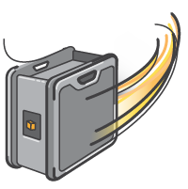
Amazon Snowball Edge and Snowcone
Terabyte scale data transport
Uses secure appliances
Faster than Internet for significant data sets
Import into S3
HIPAA Compliant
Notes:
The AWS Snow Family helps customers that need to run operations in austere, non-data center environments, and in locations where there's lack of consistent network connectivity. The Snow Family, comprised of AWS Snowcone, AWS Snowball, and AWS Snowmobile, offers a number of physical devices and capacity points, most with built-in computing capabilities. These services help physically transport up to exabytes of data into and out of AWS. Snow Family devices are owned and managed by AWS and integrate with AWS security, monitoring, storage management, and computing capabilities.

Slide 75
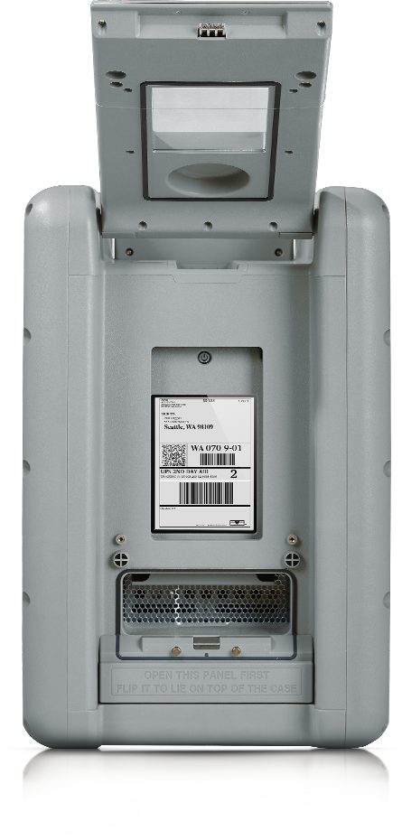
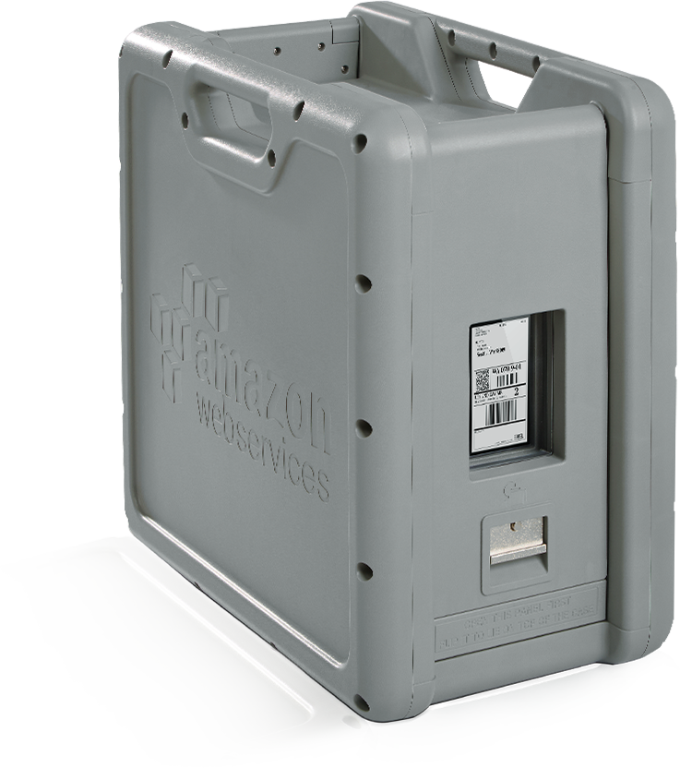
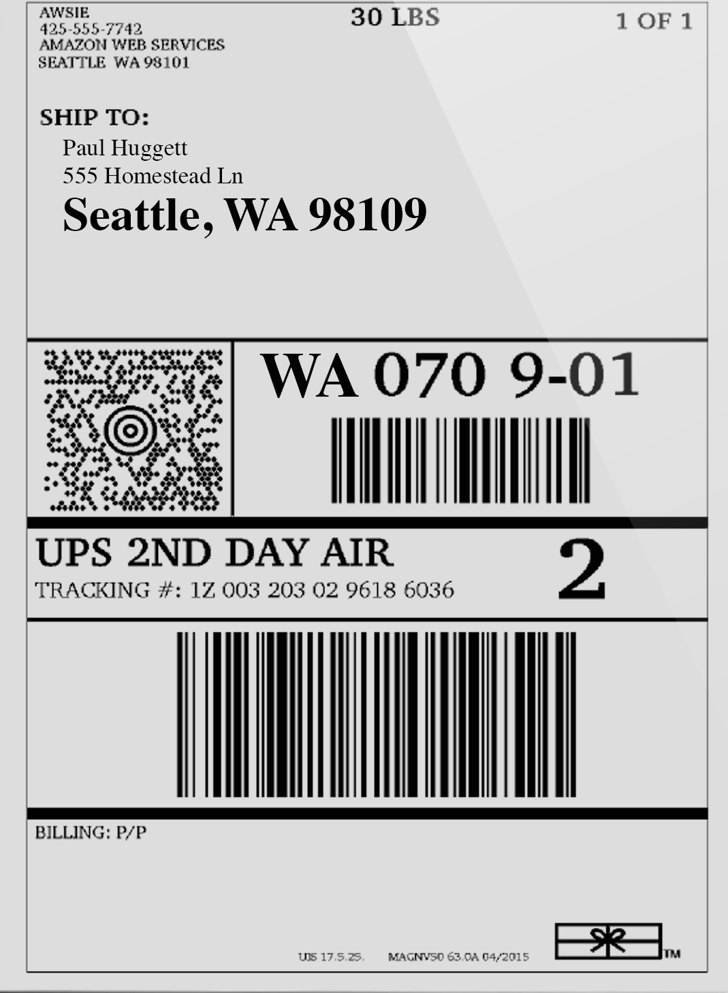
What is Snowball?
Terabyte scale data transport
Ruggedized
case
“8.5G Impact”
Rain & dust resistant
E-ink shipping label
Tamper-resistant
case & electronics
All data encrypted end-to-end
80 TB
10G network
Notes:
What is AWS Import/Export Snowball?
Snowball is a new AWS Import/Export offering that provides a terabyte-scale data transfer service that uses Amazon-provided storage devices for transport. Previously customers purchased their own portable storage devices and used these devices to ship their data. With the launch of Snowball customers are now able to use
highly secure, rugged Amazon-owned Network Attached Storage (NAS) devices, called Snowballs, to ship their data. Once received and set up, customers are able to copy up to 50TB data from their on prem file system to the Snowball via the Snowball client software via a 10Gbps network interface . Prior to transfer to the Snowball all data is encrypted by 256-bit GSM encryption by the client. When customers finish transferring data to the device they simply ship it back to an AWS facility where the data is ingested
at high speed into Amazon S3.

Slide 76

2 Snowball Edge options
Compute optimized
Storage optimized
42 TB usable S3 compatible storage
52 vCPUs, 208 GiB of memory
Optional NVIDIA Tesla V100 GPU
sbe-c and sbe-g instances (equivalent to C5, M5a, G3, P3)
80 TB usable S3-compatible storage
sbe1 instances (equivalent to C5)
Up to 40 vCPUs, 80 GiB of memory, 1 TB SATA SSD
Object storage clustering available
Long-term deployment options: 1- and 3-year discounted pricing
Notes:
AWS Snowball, a part of the AWS Snow Family, is an edge computing, data migration, and edge storage device that comes in two options. Snowball Edge Storage Optimized devices provide both block storage and Amazon S3-compatible object storage, and 40 vCPUs. They are well suited for local storage and large scale-data transfer. Snowball Edge Compute Optimized devices provide 52 vCPUs, block and object storage, and an optional GPU for use cases like advanced machine learning and full motion video analysis in disconnected environments. You can use these devices for data collection, machine learning and processing, and storage in environments with intermittent connectivity (like manufacturing, industrial, and transportation) or in extremely remote locations (like military or maritime operations) before shipping them back to AWS. These devices may also be rack mounted and clustered together to build larger temporary installations.
Snowball supports specific Amazon EC2 instance types and AWS Lambda functions, so you can develop and test in the AWS Cloud, then deploy applications on devices in remote locations to collect, pre-process, and ship the data to AWS. Common use cases include data migration, data transport, image collation, IoT sensor stream capture, and machine learning.

Slide 77

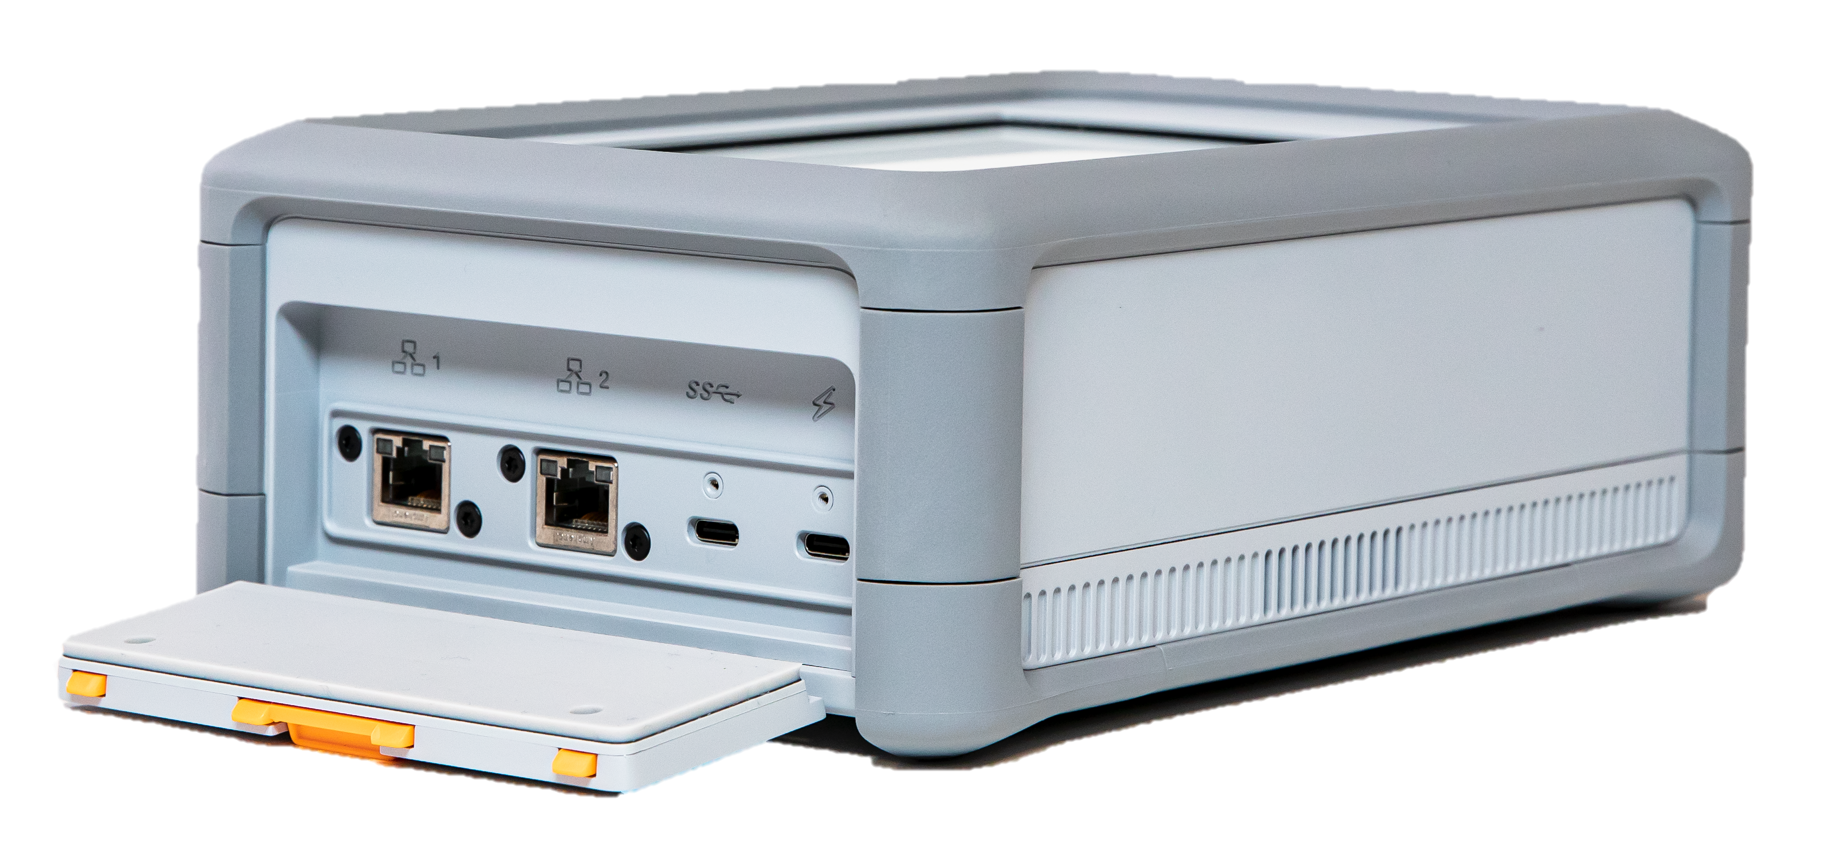
Introducing AWS Snowcone Small, portable, rugged, and secure edge computing and data transfer device
Military-grade security
4.5 pounds (2.1 kg)
Portable computing, anywhere
Withstands harsh environments
Offline & online data transfer
8 TB of storage
2 CPU, 4 GB compute
Use cases
Industrial IoT, healthcare IoT, content distribution, content aggregation, data migration, logistics, autonomous vehicles, and transportation
Notes:
AWS Snowcone is the smallest member of the AWS Snow Family of edge computing, edge storage, and data transfer devices, weighing in at 4.5 pounds (2.1 kg) with 8 terabytes of usable storage. Snowcone is ruggedized, secure, and purpose-built for use outside of a traditional data center. Its small form factor makes it a perfect fit for tight spaces or where portability is a necessity and network connectivity is unreliable. You can use Snowcone in backpacks on first responders, or for IoT, vehicular, and drone use cases. You can execute compute applications at the edge, and you can ship the device with data to AWS for offline data transfer, or you can transfer data online with AWS DataSync from edge locations.
Like AWS Snowball, Snowcone has multiple layers of security and encryption. You can use either of these services to run edge computing workloads, or to collect, process, and transfer data to AWS. Snowcone is designed for data migration needs up to 8 terabytes per device and from space-constrained environments where AWS Snowball devices will not fit.

Slide 78
How fast is Snowball?
Less than 1 day to transfer 250TB via 5x10G connections with 5 Snowballs, less than 1 week including shipping
Number of days to transfer 250TB via the Internet at typical utilizations
Notes:
Compare and contrast Internet vs 5x Snowball.
Note that with 80TB Snowball or 100TB Snowball Edge, less devices needed
Snowball Edge supports up to 40GB connections (QSFP+)
Also note you can also use Snowball Edge to run edge computing workloads such as performing local analysis of data on a Snowball Edge cluster and writing it to the S3-compatible endpoint

Slide 79
AWS Snow Family for data collection & data movement
 | Snowcone | Snowball Edge Storage Optimized | Snowmobile
Migration size | Up to 24 TB, online and offline | Up to petabytes, offline | Up to exabytes offline
Form factor | Rugged 8.5 G impact cases that are rain and dust resistant, E Ink label for shipping automation |  | 45-foot container, scheduled delivery
Security | 256-bit encryption, tamper detection |  | Encryption, security staff, GPS tracking, video surveillance, alarms
Storage capacity | 8 TB usable | 80 TB usable | <100 PB
DataSync agent | Pre-installed | - | -
Compute | 2 vCPU, 4 GB RAM usable | 40 vCPU, 80 GB RAM, 1 TB SSD usable | -
Onboard computing options | AWS IoT Greengrass functions Amazon EC2 AMIs
Wireless | Wi-Fi | - | -
Portable or Mobile use | Battery based operation | - | -
Clustering | - | Up to 15 nodes | -
Visit the AWS Snow Family page for a more detailed comparison »

Slide 80
Amazon Snowmobile
https://www.youtube.com/watch?v=8vQmTZTq7nw
Notes:
AWS Snowmobile is an Exabyte-scale data transfer service used to move extremely large amounts of data to AWS. You can transfer up to 100PB per Snowmobile, a 45-foot long ruggedized shipping container, pulled by a semi-trailer truck. Snowmobile makes it easy to move massive volumes of data to the cloud, including video libraries, image repositories, or even a complete data center migration. Transferring data with Snowmobile is more secure, fast and cost effective.
After an initial assessment, a Snowmobile will be transported to your data center and AWS personnel will configure it for you so it can be accessed as a network storage target. When your Snowmobile is on site, AWS personnel will work with your team to connect a removable, high-speed network switch from Snowmobile to your local network and you can begin your high-speed data transfer from any number of sources within your data center to the Snowmobile. After your data is loaded, Snowmobile is driven back to AWS where your data is imported into Amazon S3.
Snowmobile uses multiple layers of security to help protect your data including dedicated security personnel, GPS tracking, alarm monitoring, 24/7 video surveillance, and an optional escort security vehicle while in transit. All data is encrypted with 256-bit encryption keys you manage through the AWS Key Management Service (KMS) and designed for security and full chain-of-custody of your data.

Slide 81
AWS Transfer Family
Notes:
So what is AWS Transfer Family and how does it work? The AWS Transfer Family provides fully managed support for file transfers directly into and out of Amazon S3 and just announced, Amazon Elastic File Service (EFS). With support for Secure File Transfer Protocol (SFTP), File Transfer Protocol over SSL (FTPS), and File Transfer Protocol (FTP), the AWS Transfer Family helps you seamlessly migrate your file transfer workflows to AWS by integrating with existing authentication systems, and providing DNS routing with Amazon Route 53 so nothing changes for your customers and partners, or their applications. With your data in Amazon S3 or EFS, you can use it with AWS services for processing, analytics, machine learning, and archiving. Getting started with the AWS Transfer Family is easy; there is no infrastructure to buy and set up.

Slide 82

Managed file transfer – what is it?
Managed file transfer (MFT) provides secure and reliable transfer of data between systems through a network (e.g., the Internet), enabling exchange of data to meet business critical needs
Attributes
Focused on secure and flexible file transfers
Support 3rd party integrations and connectors
Provide pre-processing for data filtering and encryption
May support additional protocols (AS2/HTTPS)
Notes:
Managed file transfer (MFT) is a technology platform that allows organizations to reliably exchange electronic data between systems and people in a secure way to meet compliance needs. These data movements can be both internal and external to an enterprise and include various types, including sensitive, compliance-protected or high-volume data.
What are the attributes of workloads we see customers label “managed file transfer”?
These are workflows where file movement is enabled, commonly using SFTP, FTPS, FTP protocols and others, by some sort of software stack
Often these are licensed software packages, and they focus on secure and flexible file transfers
Usually these software packages allow for 3rd party identity provider tie ins
These packages may also allow for workflow extensions such as on demand file encryption, decryption, and sending the files elsewhere once they are received using event triggers.
Additionally, these software packages often support additional protocols outside SFTP/FTPS and FTP, offering a common user experience across each.

Slide 83
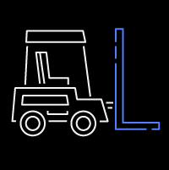

AWS Transfer Family benefits
Fully Managed
Seamless Migration
Secure & Compliant
AWS Integrated
Highly available across 3 Availability Zones
Scales on demand
Supports thousands of concurrent users
Import host keys
Use your own IP addresses and hostnames
Use existing authentication systems
IP filtering
Support for VPC endpoints and shared VPC environments
Data encryption options via SSE-S3 and AWS KMS
PCI, HIPAA, SOC3, FIPS compliance
Store and access data natively using AWS services
AWS CloudTrail and Amazon CloudWatch for auditing/logging
Custom authentication using Amazon API Gateway and AWS Lambda
Notes:
Let’s dive into the benefits of AWS Transfer Family.
Transfer Family is a fully managed service that scales in real time to meet customer needs while supporting thousands of users.
There is no need to modify applications or run any file transfer protocol infrastructure. Transfer Family is fully compatible with SFTP, FTPS, and FTP standards and connects directly with identity provider systems like Active Directory, LDAP, Okta, and others. Customers can migrate file transfer workflows to AWS without changing existing authentication systems, domain, and hostnames.
Transfer Family is PCI, HIPAA, SOC3, and FIPS compliant to ensure files are transferred through a secure, encrypted channel. We’ll dive a little deeper into Transfer Family’s security and compliance next.
Finally, data stored in Amazon S3 or EFS, makes it easy to use AWS services for processing and analytics workflows, unlike third party tools that may keep files in silos. Native support for AWS management services simplifies security, monitoring, and auditing operations.

Slide 84





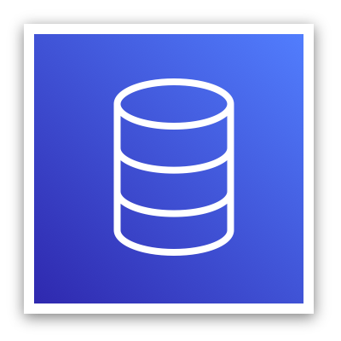
AWS Transfer Family Value
Seamlessly migrate without impacting your workflows
AWS Cloud
Users and clients
Data available for use with other AWS services
Machine Learning
SFTP, FTPS, FTP
Data Lake
AWS Transfer Family
AWS Storage Services
Analytics
No change to existing workflows, applications, or clients
No infrastructure to manage
Database
Notes:
AWS Transfer Family enables customers to transfer files into and out of S3 and EFS storage over the following protocols: Secure Shell (SSH) File Transfer Protocol (SFTP), File Transfer Protocol Secure (FTPS), and finally File Transfer Protocol (FTP). Users can seamlessly migrate file transfer workflows by maintaining existing client-side configurations for authentication, access, and firewalls — so nothing changes for customers, partners, and internal teams, or their applications. Use existing authentication systems, domain and hostnames while exchanging files with customer and partners without changing their applications, processes, client software configurations, or behavior. With just a few clicks in the AWS Transfer Family console, customers can select one or more protocols, configure Amazon S3 or EFS buckets to store the transferred data, and set up end user authentication by importing existing end user credentials, or integrating an identity provider like Microsoft Active Directory or LDAP. End users can continue to transfer files using existing clients, while files are stored in an Amazon S3 or EFS bucket

Slide 85
Common use cases
Data lakes and analytics platforms
Customer relationship management applications
Subscription based data products
Digital media content aggregation and distribution
Enterprise resource planning and electronic data interchange for supply chain logistics
IoT services used in remote locations for monitoring
Notes:
SFTP is a widely used protocol that has been around for many years. As such, it is deeply embedded in a wide variety of workloads that span many areas of the enterprise, as well as many different industries. We launched AWS Transfer for SFTP in November 2018. In Q2 2020, we added FTPS and FTP, now supporting three of the most commonly used data transfer protocols. Now, with support for transfers over SFTP, FTPS, and FTP in and out of Amazon S3 and EFS, AWS customers can easily integrate their file transfer workflows with data lakes, customer relationship management (CRM), enterprise resource planning (ERP), and other business applications in AWS.
Many companies still rely on SFTP to share and move data. For example, if you need to receive third party uploads, say you’re in a pharma company like Bristol Myers Squibb and you receive medical prescription data or if you’re an online real estate mortgage company and need to receive interest rates from banks on a regular basis. Or if you’re an advertising tech company and need to receive files associated with an upcoming ad campaign, SFTP may very likely be your protocol of choice for its reliability and security.
Another use case is sharing data with your customers. You might have a pay-per-subscription data service, and you want to provide FTPS as yet another channel to distribute the data stored in the cloud.
Or maybe you use FTP in your own internal organization for transfers, and it may be hard to change to other protocols as you move all your on-premises data to the cloud.

Slide 86


Get started with AWS Transfer Family
1
Launch a server endpoint
2
Select your target S3 bucket(s) or EFS file share(s)
3
Configure your users
Visit console.aws.amazon.com/transfer to get started today!
Pricing
Server endpoint time: $0.30/protocol/hour
Data uploads and downloads: $0.04/GB
Examples:
10 GB/day costs $2.7K/year
100 GB/day costs $3.6K/year
Learn more: aws.amazon.com/aws-transfer-family/pricing/
Notes:
With the AWS Transfer Family, customers only pay for the protocols they have enabled for access to their endpoints and the amount of data transferred over each of the protocols. There are no upfront costs and no resources to manage. Customers select the protocols, identity provider, and endpoint configuration to enable transfers over the chosen protocols. They are billed on an hourly basis for each of the protocols enabled to access their endpoint, until the time they delete it. They are also billed based on the amount of data (Gigabytes) uploaded and downloaded over each of the protocols. Please note: customers are charged standard request, storage, and data transfer rates to read to and write from Amazon S3 and EFS. When transferring data in and out of the service, customers pay standard AWS Data Transfer rates. Customers are also charged standard rates for Amazon Route 53 domain name lookups, API Gateway, Lambda invocations to access identity datastores, Amazon CloudTrail, and CloudWatch Logs and Events.
The service is setup in 3 basic steps:
First, Map a hostname with the server endpoint. (or create a new hostname, if needed.)
Second, Select the existing (or new) S3 or EFS bucket for storing the data.
Third, Configure the users. Users can be configured from within the service, or a custom identity provider can be used.

Slide 87
5
Backup

Slide 88
AWS Backup

Slide 89
AWS Backup – meeting the challenges
Backup operations unified across AWS services
Complexity
Compliance
Cost
Simple & Performant
Reliable & Secure
Cost Effective
Policy- and tag-based backup solution
Centralized backup activity monitoring and logs
No added cost for orchestration
Automated backup retention management
Backup access policies
Automated backup scheduling
Backup encryption
Notes:
Complexity - when AWS built these DP services, they used the same underlying microservices, but the management was all one-off. Customers solve this via pro-serve, their own scripting, or consulting services. Add in the many brains and hands needed to manage all that, and complexity increases steadily.
Compliance - Most of our customers use more than one service. If they are using EFS, chances are they are using EBS too, or RDS or Aurora. Every organization has an eye toward compliance, and with the rapid adoption of different services, your overall backup plans, and compliance, can get difficult to manage if you’re not careful.
Cost - The problem and challenge that resulted from all this fast growth in the AWS cloud is where some of our customers needed to contract a lot of professional services, and keep a close eye on managing things to make sure they remain in compliance with regulators, and on-plan with their DR operations. Trying to maintain consistent policies and everything is where we saw a lot of demand start to occur. They didn’t have a lot of options, lots of scripting, manual operations, a lot of inefficiency that could be automated and fully managed – which is where AWS Backup comes in.
------------------------
CLICK NEXT---------------------
If we look again at the challenges, AWS Backup lines up nicely.
AWS Backup is built around a Backup Plan, or set of rules that define the backup. The rules include items such as when to start the backups, the duration of the backup window, and the retention period.
One of the core capabilities of AWS Backup is the ability to utilize tags to affect the backup of resources you’d like to protect.
You can use AWS Backup’s central console to view what AWS resources are being protected and monitor backup and restore activity. You can use AWS Backup to identify and restore from a backup, creating a new resource.

Slide 90





















How AWS Backup works
Supported AWS Services
With AWS Backup, you can:
Create backup plans that orchestrate backup operations per policy
Secure backups and manage restore processes
Control access for managed resources via IAM
Setup notifications/logging via Amazon SNS, AWS CloudTrail & AWS CloudWatch
Scale through AWS Organizations
Protect EC2 Windows/SQL with app consistency
Backup to other accounts to protect against multiple threats
FSx for
Lustre
EBS
EC2
EFS
Operators
Storage Gateway
FSx for
Windows
RDS
Aurora
DynamoDB
AWS IAM
AWS
Organizations
Backups
Backup
Plan
Admin
AWS CloudTrail
Amazon CloudWatch
Cross Account Backup
Amazon SNS
AWS Backup
Backup Vault
Notes:
Covering 9 services now – we plan to cover all stateful services over time.
We bring a lot of free, no charge functionality under the hood that automates, orchestrates and removes complexity. Such as our integrations with AWS Orgs, CloudWatch, EventBridge, CloudTrail, SNS.
MAIN attraction to our customers has been the cloud native aspect. Working in the cloud with the same microservices. Being able to bring in other integrations as needed.
Other discussion – Why customers use AWS Backup:
Fixes the issue limited choices within the individual service consoles
Avoid scripting and other tooling
Unify backup solutions where possible
Avoid the complexity of on-premises backups being done by different groups
Separate IAM controls for all roles
Lock down roles and credentials for access
Reduces threat vectors on your data
Helps DBAs, Storage Admins and Application devs to stay compliant
Maintains centralized control for organization
CloudWatch, CloudTrail & SNS integration
Create audit and compliance alerts, reports, dashboards across all backups

Slide 91
DR & Ransomware Recovery with AWS Backup
Recovery options:
Supports 1-to-many, many-to-many, many-to-1, etc.
Recover from same account locally or from across region
Recover from cross-account locally or across region
Recover from RPOs that are hours, days, weeks or months old
Simple workflow to apply any forensic analysis
AWS Backup
Vault characteristics:
Backups are highly efficient incremental forever
Backup copies cannot be changed or encrypted
Manage with vault specific CMK/KMS best practices
Air-gapped backups using vault access policies
Prescriptive guidance for vault account access provided
Notes:
Many customers have asked us to enable backups to other accounts. The primary goal is for insider threat or cyber attack mitigation. Customers want to allow the data into another AWS Org account easily and seamlessly, but with separate credentials from the Org Root and Org Master Manager accounts, to provide maximum separation and protection from compromises, and secure against data leakage.
CAB also protects against other Org members who seek to destroy or damage data resources.
Best Practice: Shared CMK must reside in destination account
Note: Management and backup admin accounts can still pose a threat to backup data in the destination vault if their credentials are compromised.
AWS Backup and AWS Organizations bring cross-account backup feature
Setting Access Policies on Backup Vaults and Recovery Points
https://docs.aws.amazon.com/aws-backup/latest/devguide/creating-a-vault-access-policy.html
Deny Access to a Backup Vault
https://docs.aws.amazon.com/aws-backup/latest/devguide/creating-a-vault-access-policy.html#deny-access-to-a-backup-vault
Managing access permissions for your AWS organization
https://docs.aws.amazon.com/organizations/latest/userguide/orgs_permissions_overview.html
Closing an AWS account
https://docs.aws.amazon.com/organizations/latest/userguide/orgs_manage_accounts_close.html
Can I reopen my closed AWS account?
https://aws.amazon.com/premiumsupport/knowledge-center/reopen-aws-account/

Slide 92





AWS Backup Pricing US East (N.Virginia)
Amazon
EFS
Amazon
EBS
Amazon
RDS
DynamoDB
AWS Storage Gateway
FSx
Amazon Aurora
Warm storage ($ per GB / month)
Cold storage ($ per GB / month)
Restore from warm ($ per GB)
Restore from cold ($ per GB)
$0.05 | $0.05 | $0.095 | $0.10 | $0.05 | $0.05 | $0.021
$0.01 | na | na | na | na | na | na
$0.02 | Free | Free | $0.15 | Free | Free | Free
$0.03 | na | na | na | na | na | na
*Minimum storage period for cold tier is 90 days
Notes:
Pricing for AWS Backup is very straight forward. The orchestration is free, there is no charge. You only pay for the storage you utilize in your backup activity. You will see the charges in your bill for that service, like EC2, or RDS, or DDB.
The only difference is with EFS, as it is using AWS Backup as its backup storage service, so there are some options that cost extra, like single restore, or Cold Storage. Those options are not available with other services just yet.

Slide 93
Customers who can benefit the most with AWS Backup
Customers who:
…want to optimize for compliance and want to standardize the way data protection is performed
…want to optimize for efficiency to reduce their own script dependencies to protect AWS resources (EBS, RDS, EC2, etc.)
…want to improve productivity with re-use of copies for things like test/dev, QA and CI/CD
…want to to protect against insider threats and ransomware
…want centralized control and security for extensive recovery options in the cloud
External Website:
https://aws.amazon.com/backup/resources/
Blogs, Videos, Documentation, FAQs, articles
Notes:
Customers who:
..need to optimize for compliance
..have strong compliance requirements, need to standardize backup policies
..looking for ways to protect against insider threats and ransomware
..need to improve productivity with cross-region and cross-account-backup re-use of copies for things like test/dev, QA and CI/CD
..need optimize for backup efficiency
...are using one or more of our supported services
..have built their own scripts for protecting their AWS resources
..needs like cold storage for EFS, VSS for EC2 Windows Server / SQL / AD

Slide 94

Any Questions?

